Slide 1
St. Louis Central Corridor West Building Permits
Monthly Report: 2020

Slide 2
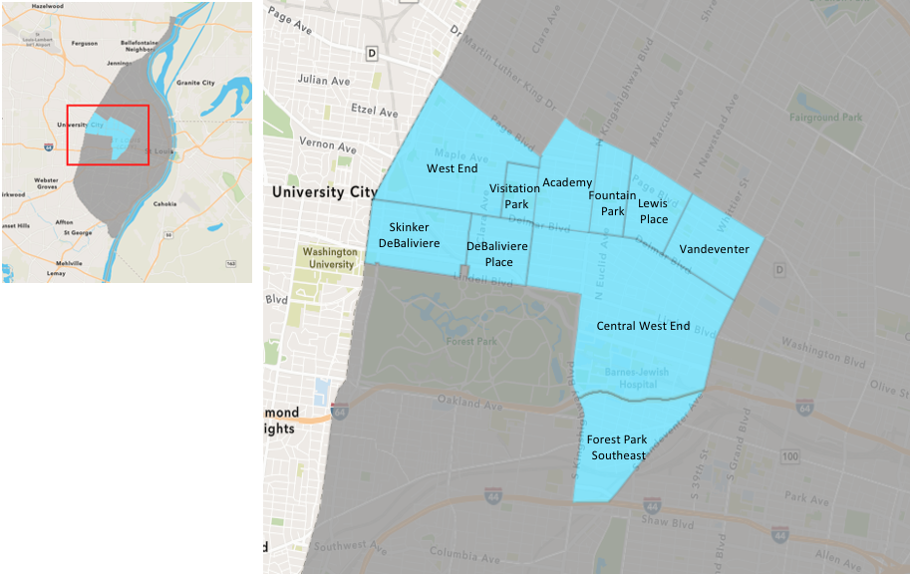
St. Louis Neighborhood Spatial Reference

Slide 3
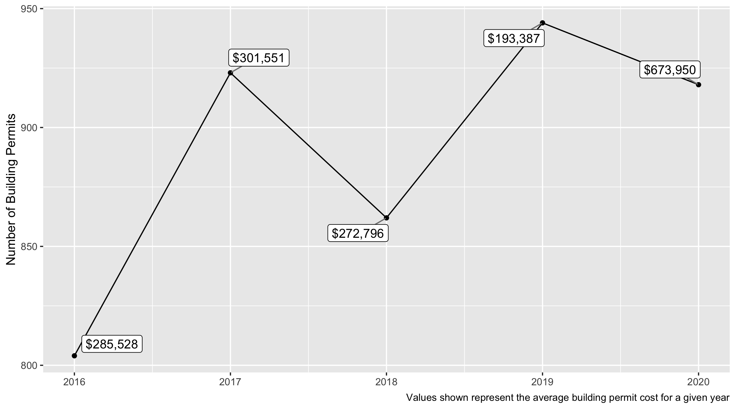
5 Year Analysis

Slide 4
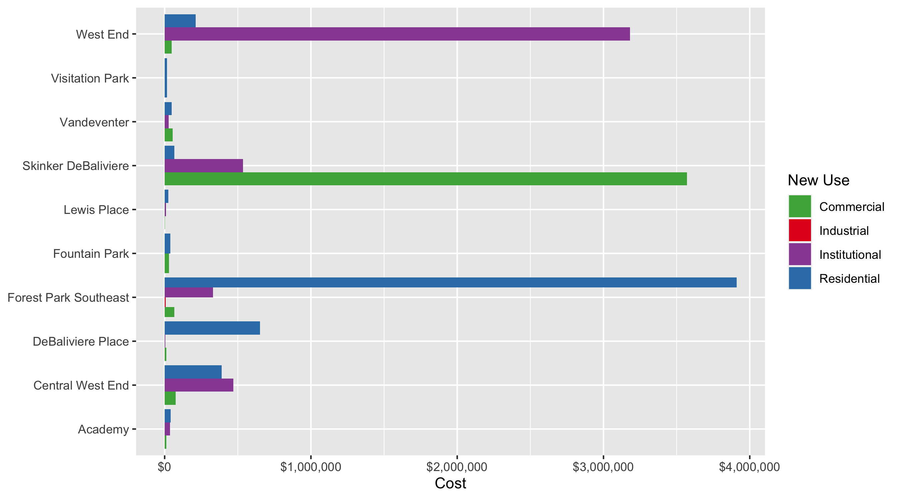
Neighborhood Summary: Average Building Permit Cost

Slide 5
Neighborhood Summary
2020 | 2020 | 2020 | 2020
Neighborhood | Average Cost | # of Permits | Total Value of Permits
Academy | 38,836.6 | 47 | 1,825,319.0
Central West End | 366,177.5 | 431 | 157,822,483.9
DeBaliviere Place | 576,828.5 | 60 | 34,609,709.5
Forest Park Southeast | 2,691,674.5 | 123 | 331,075,965.0
Fountain Park | 38,083.3 | 6 | 228,500.0
Lewis Place | 21,206.5 | 19 | 402,923.0
Skinker DeBaliviere | 544,001.0 | 124 | 67,456,127.0
Vandeventer | 43,846.8 | 16 | 701,549.0
Visitation Park | 14,966.1 | 8 | 119,729.0
West End | 290,999.8 | 84 | 24,443,986.0
2019 | 2019 | 2019 | 2019
Neighborhood | Average Cost | # of Permits | Total Value of Permits
Academy | 54,518.3 | 36 | 1,962,660.0
Central West End | 257,679.8 | 494 | 127,293,823.5
DeBaliviere Place | 50,949.6 | 56 | 2,853,180.0
Forest Park Southeast | 218,408.0 | 172 | 37,566,171.0
Fountain Park | 35,651.4 | 11 | 392,165.0
Lewis Place | 12,511.1 | 9 | 112,600.0
Skinker DeBaliviere | 21,078.1 | 75 | 1,580,854.0
Vandeventer | 111,850.1 | 33 | 3,691,052.0
Visitation Park | 8,000.0 | 1 | 8,000.0
West End | 124,498.2 | 57 | 7,096,399.0

Slide 6
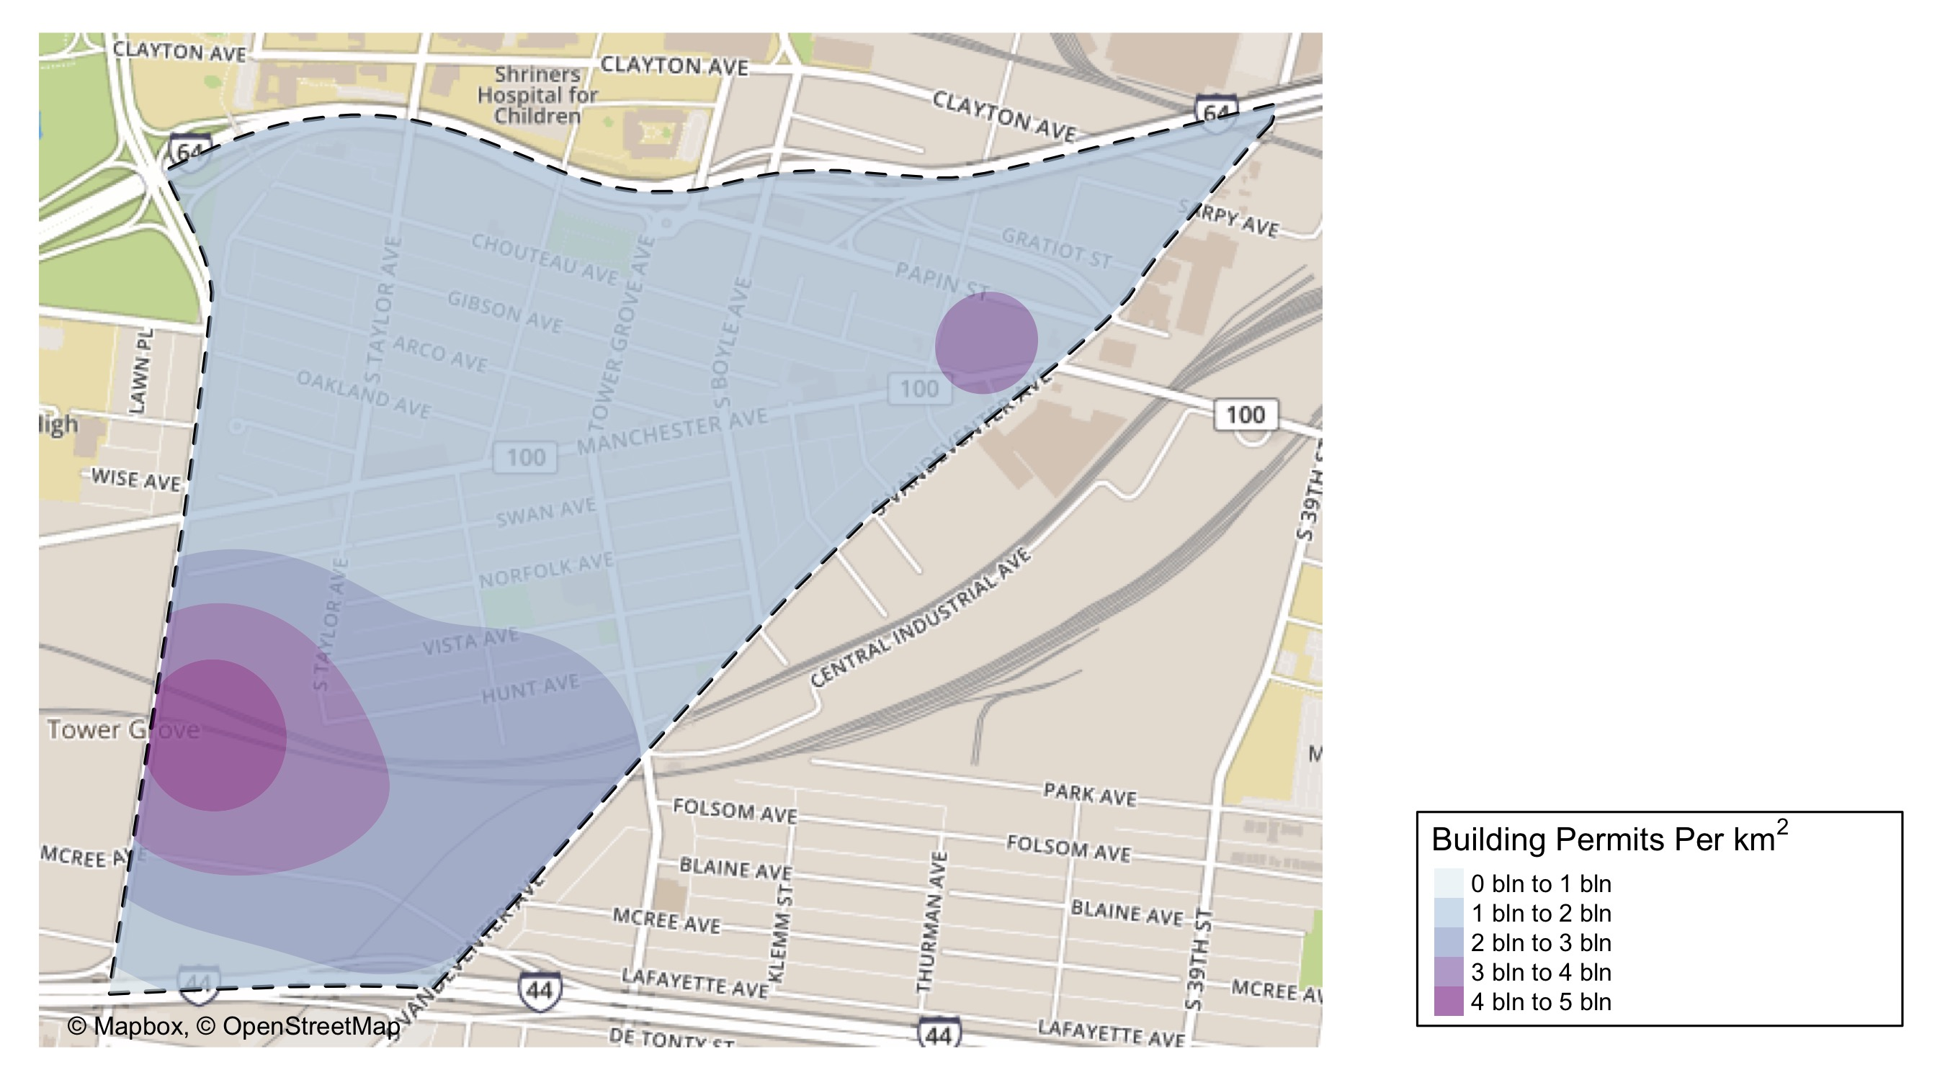
Forest Park Southeast: Building Permit Density Map

Slide 7
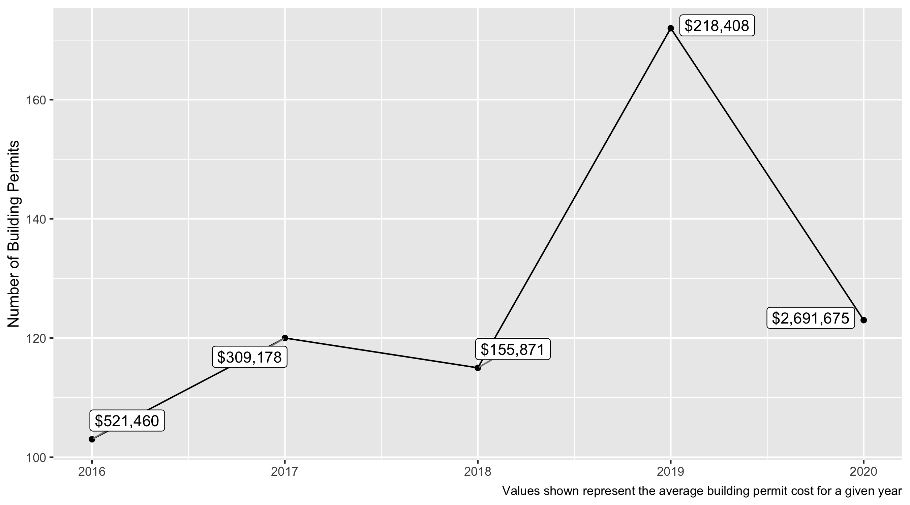
Forest Park Southeast 5 Year Analysis

Slide 8
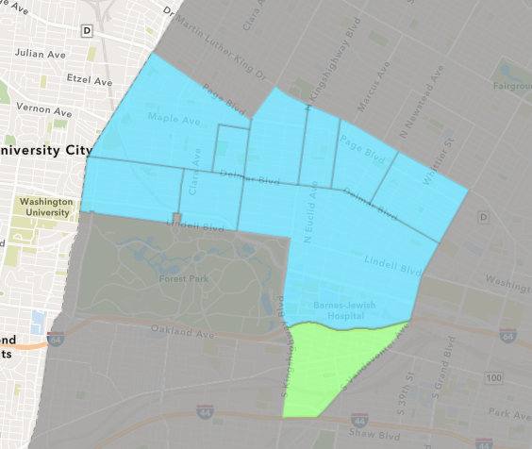
Forest Park Southeast
2020 Neighborhood Cost Breakdown
Mean: $2,691,675
Median: $10,000
Range: $50 - $300,490,140

Slide 9
Forest Park Southeast: Summary Notes
123 building permits in 2020
-28.49% change compared to 2019 (172 total building permits)
$2,691,675: Average building permit cost in 2020
1132.41% change compared to 2019 ($218,408)

Slide 10
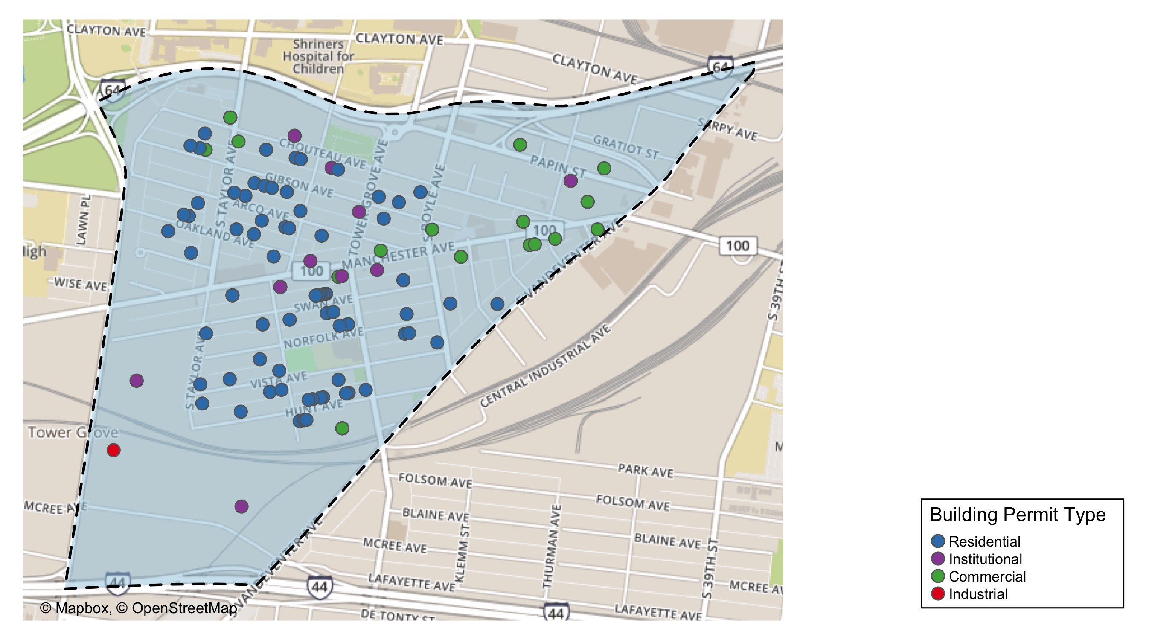
Forest Park Southeast

Slide 11
Neighborhood Summary
2020 | 2020 | 2020 | 2020
Permit Use | Average Cost | # of Permits | Total Value of Permits
Commercial | 66,625.0 | 24 | 1,599,000.0
Industrial | 6,100.0 | 1 | 6,100.0
Institutional | 331,328.5 | 15 | 4,969,928.0
Residential | 3,909,649.8 | 83 | 324,500,937.0
2019 | 2019 | 2019 | 2019
Permit Use | Average Cost | # of Permits | Total Value of Permits
Commercial | 98,519.4 | 41 | 4,039,296.0
Industrial | 13,500.0 | 2 | 27,000.0
Institutional | 699,545.2 | 23 | 16,089,540.0
Residential | 164,248.4 | 106 | 17,410,335.0

Slide 12
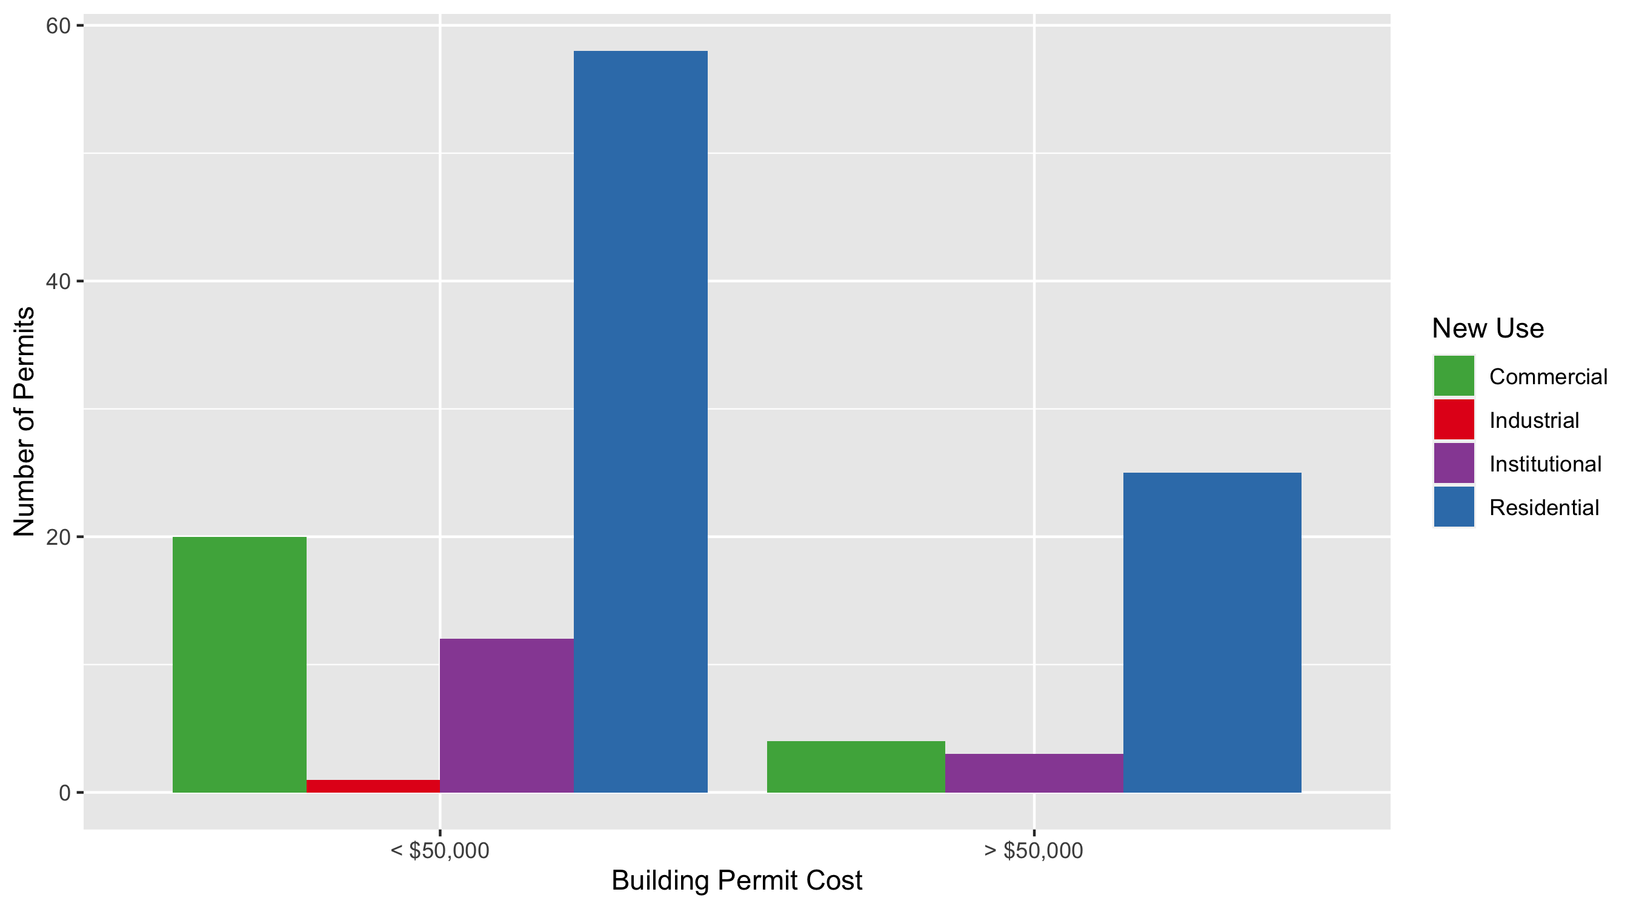
Forest Park Southeast Permit Cost Breakdown

Slide 13
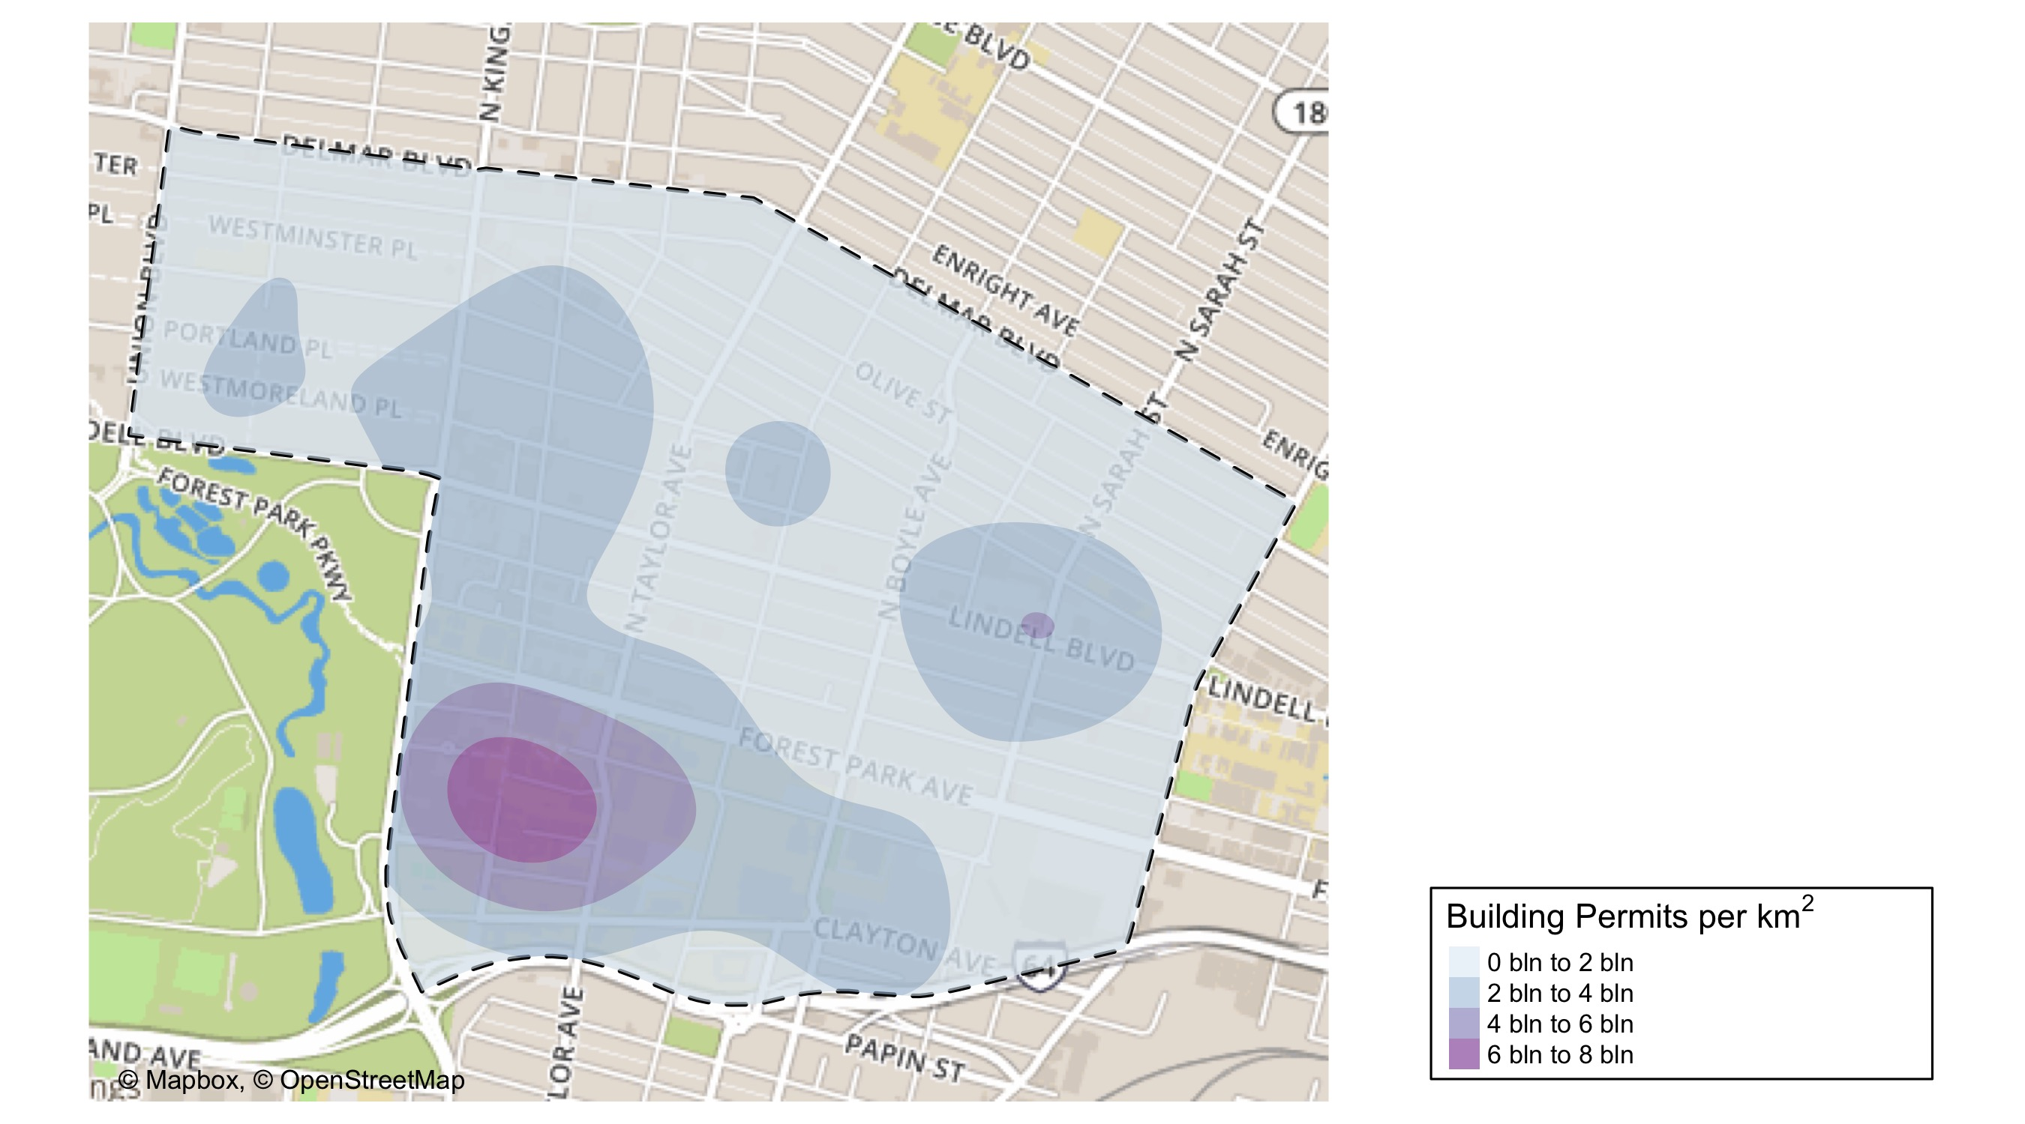
Central West End: Building Permit Density Map

Slide 14
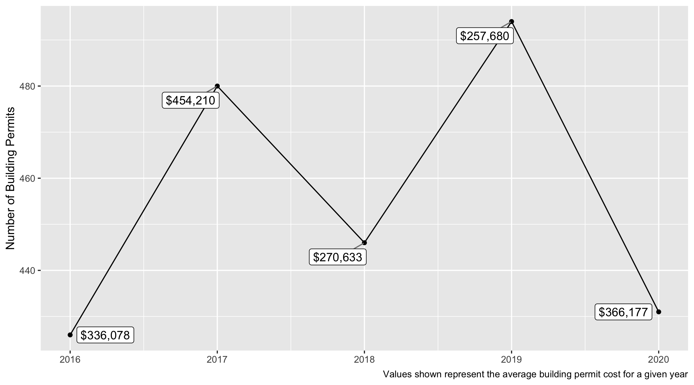
Central West End 5 Year Analysis

Slide 15
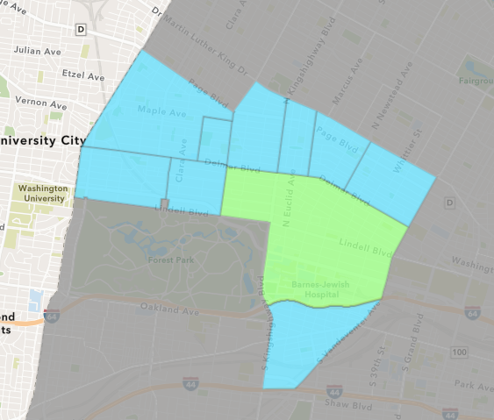
Central West End
2020 Neighborhood Cost Breakdown
Mean: $366,177
Median: $15,829
Range: $200 - $40,000,000

Slide 16
Central West End: Summary Notes
123 building permits in 2020
-28.49% change compared to 2019 (172 total building permits)
$2,691,675: Average building permit cost in 2020
1132.41% change compared to 2019 ($218,408)

Slide 17
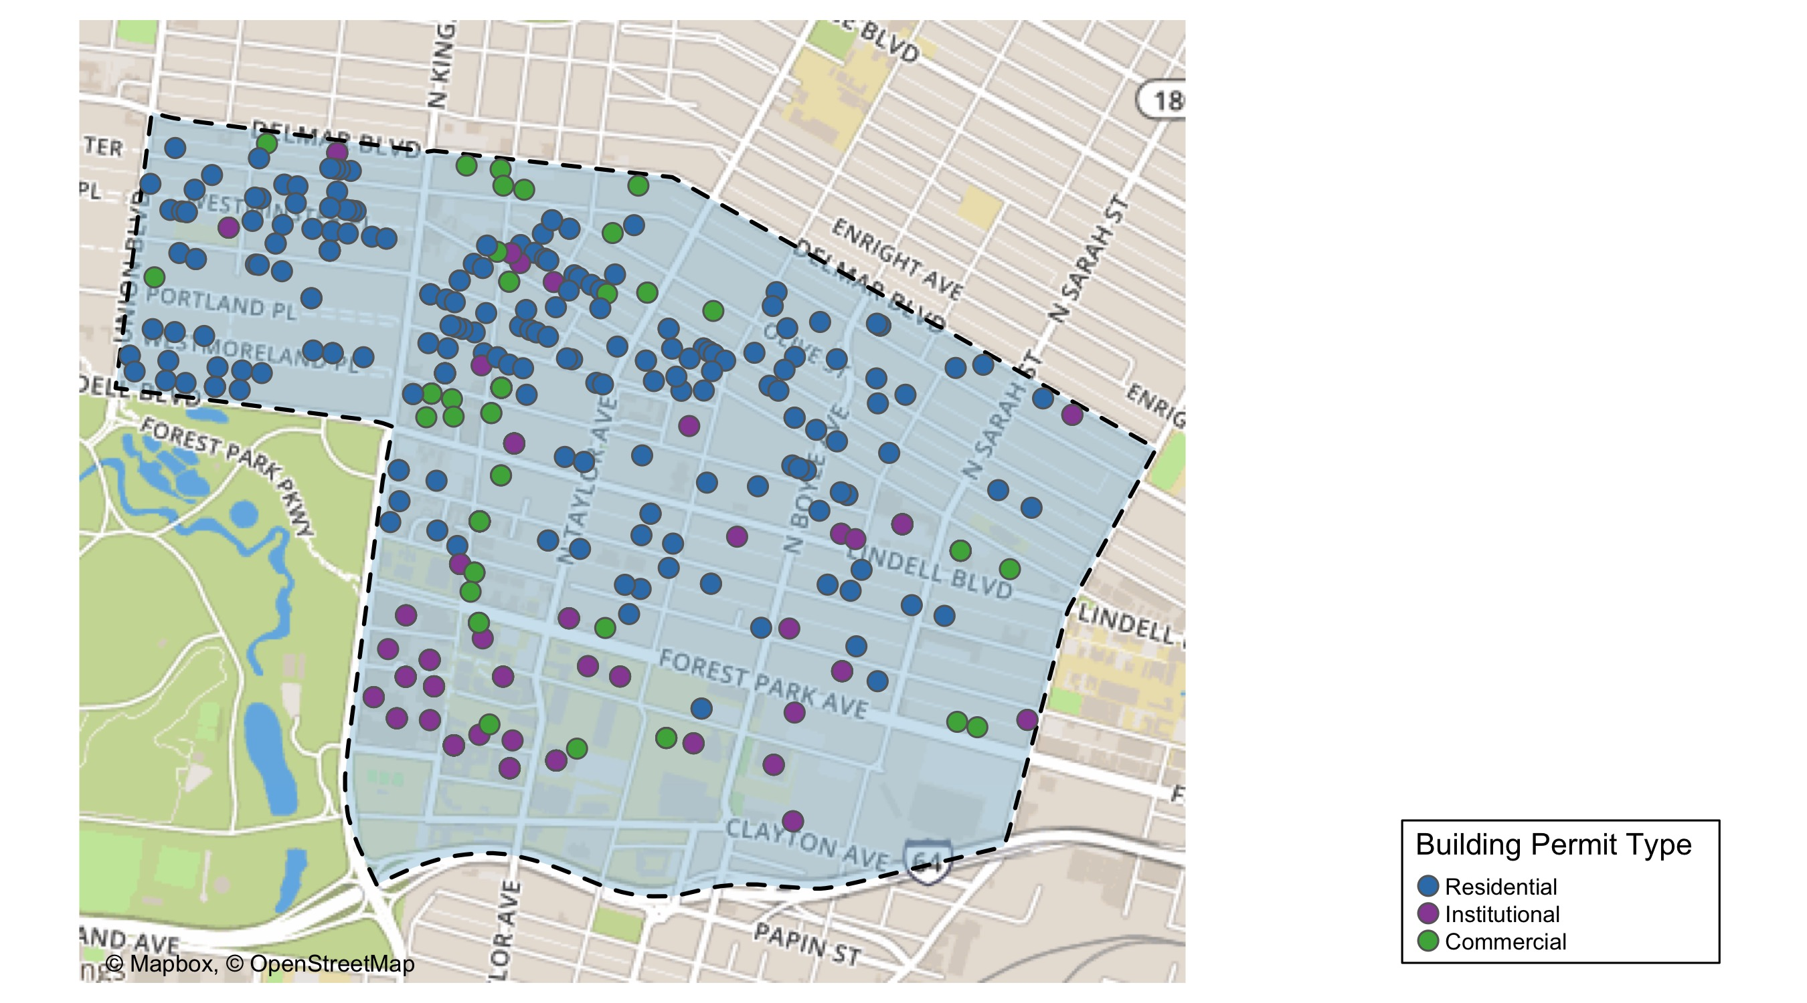
Central West End

Slide 18
Central West End
2020 | 2020 | 2020 | 2020
Permit Use | Average Cost | # of Permits | Total Value of Permits
Commercial | 76,330.3 | 69.0 | 5,266,794.0
Industrial | 0.0 | 0.0 | 0.0
Institutional | 470,109.4 | 140.0 | 65,815,321.0
Residential | 390,722.4 | 222.0 | 86,740,368.9
2019 | 2019 | 2019 | 2019
Permit Use | Average Cost | # of Permits | Total Value of Permits
Commercial | 515,058.0 | 85 | 43,779,933.0
Industrial | 5,000.0 | 2 | 10,000.0
Institutional | 360,541.9 | 210 | 75,713,793.0
Residential | 39,543.6 | 197 | 7,790,097.5

Slide 19
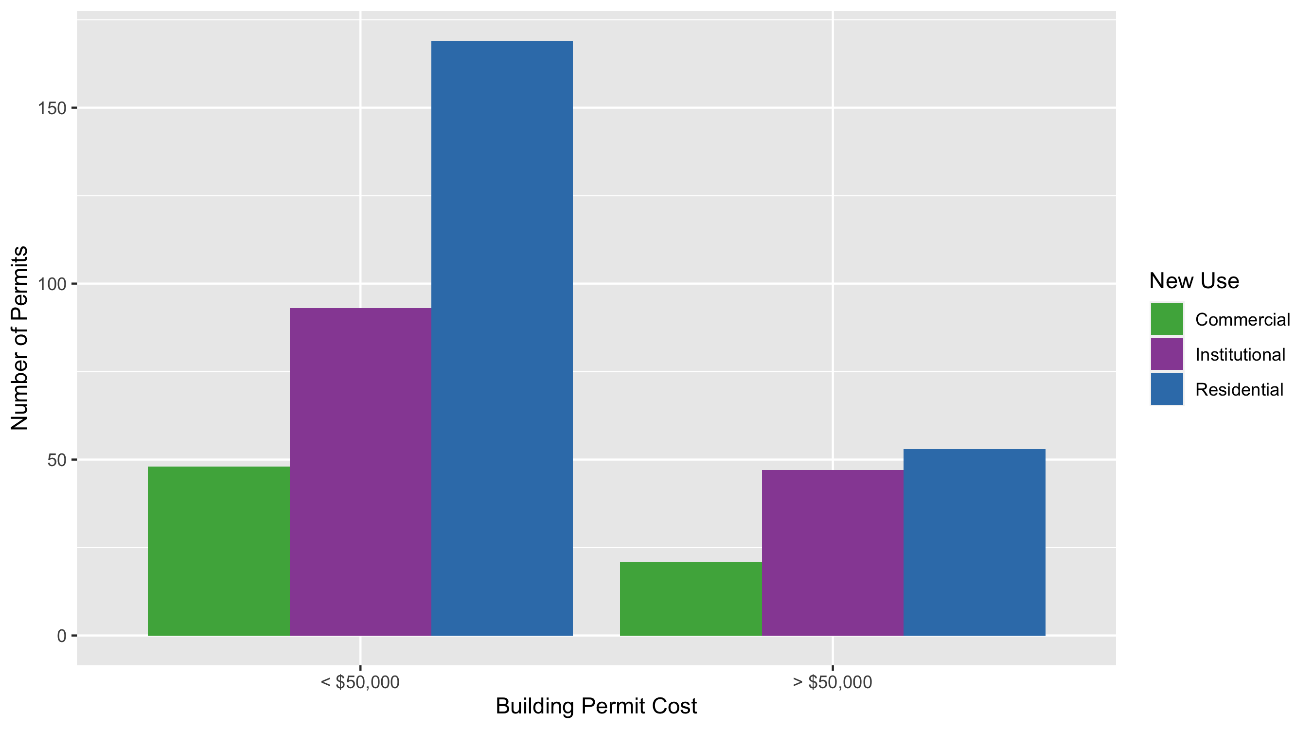
Cental West End Permit Cost Breakdown

Slide 20
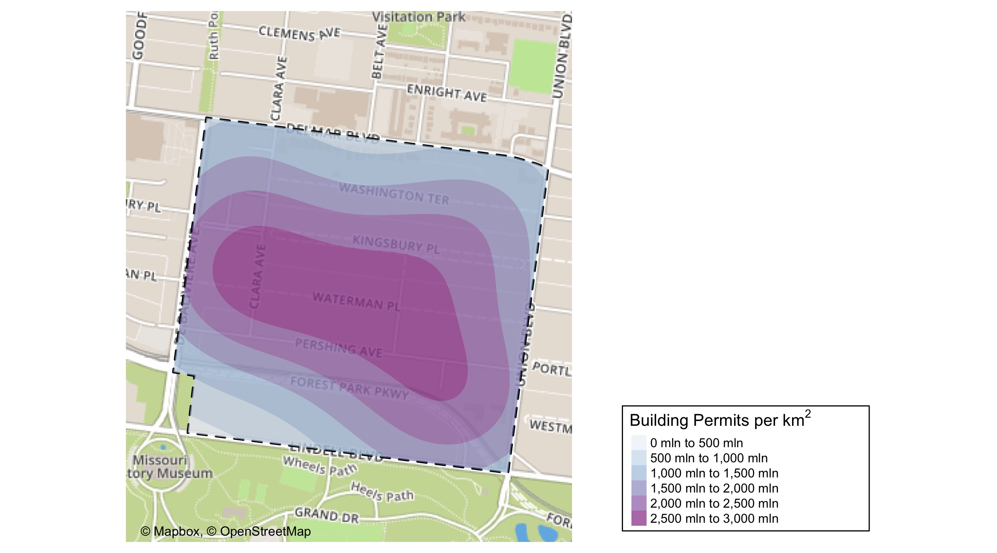
DeBaliviere Place: Crime Density Map

Slide 21
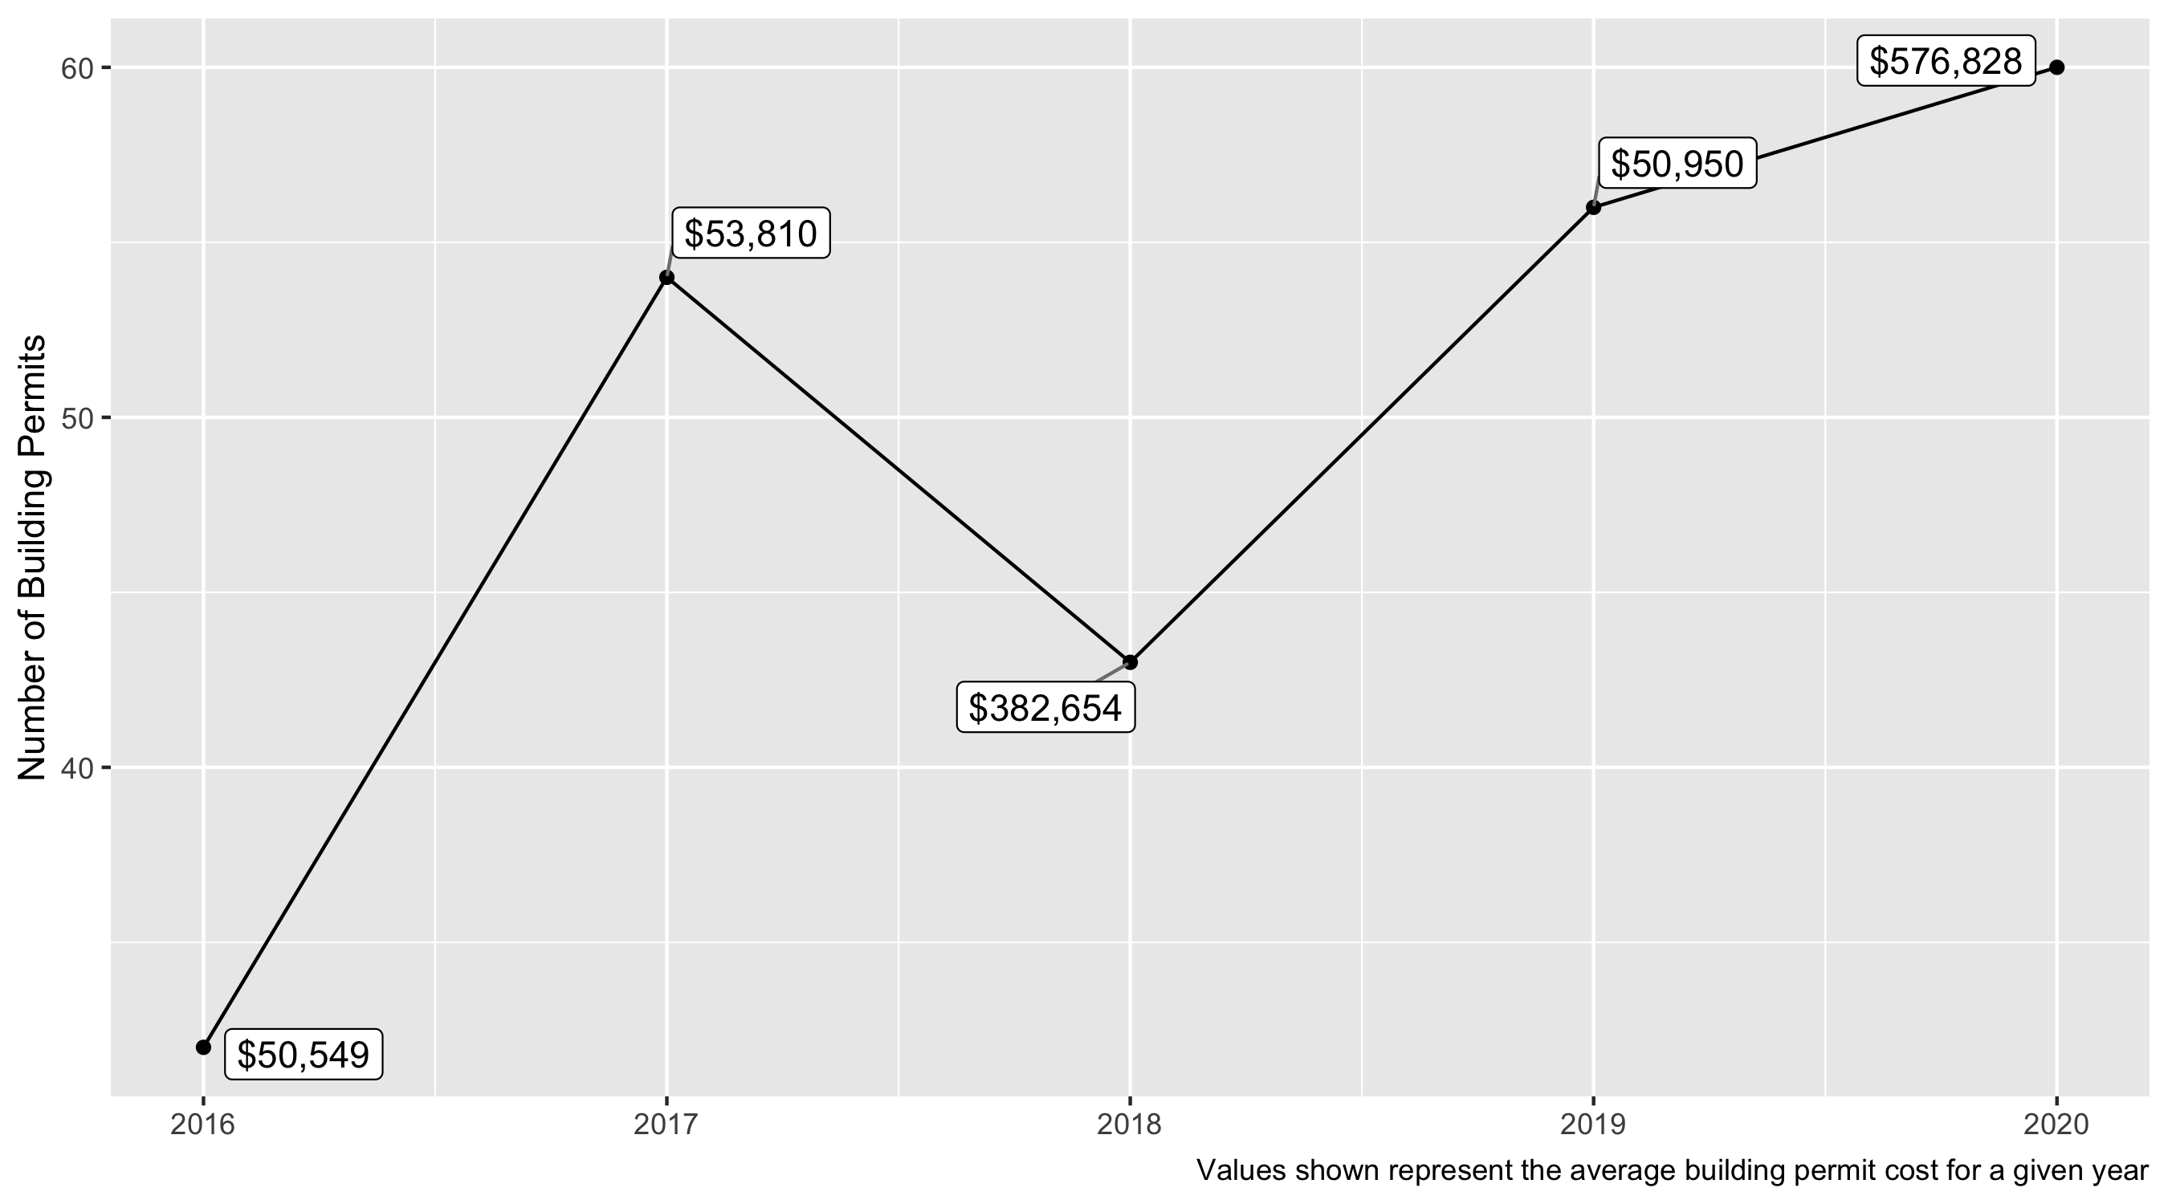
DeBaliviere Place 5 Year Analysis

Slide 22
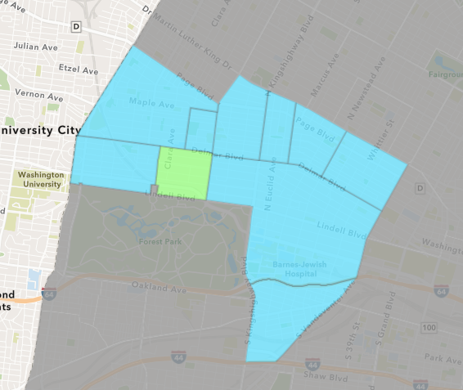
DeBaliviere Place
2020 Neighborhood Cost Breakdown
Mean: $576,828
Median: $32,500
Range: $100 - $18,000,000

Slide 23
DeBaliviere Place: Summary Notes
123 building permits in 2020
-28.49% change compared to 2019 (172 total building permits)
$2,691,675: Average building permit cost in 2020
1132.41% change compared to 2019 ($218,408)

Slide 24
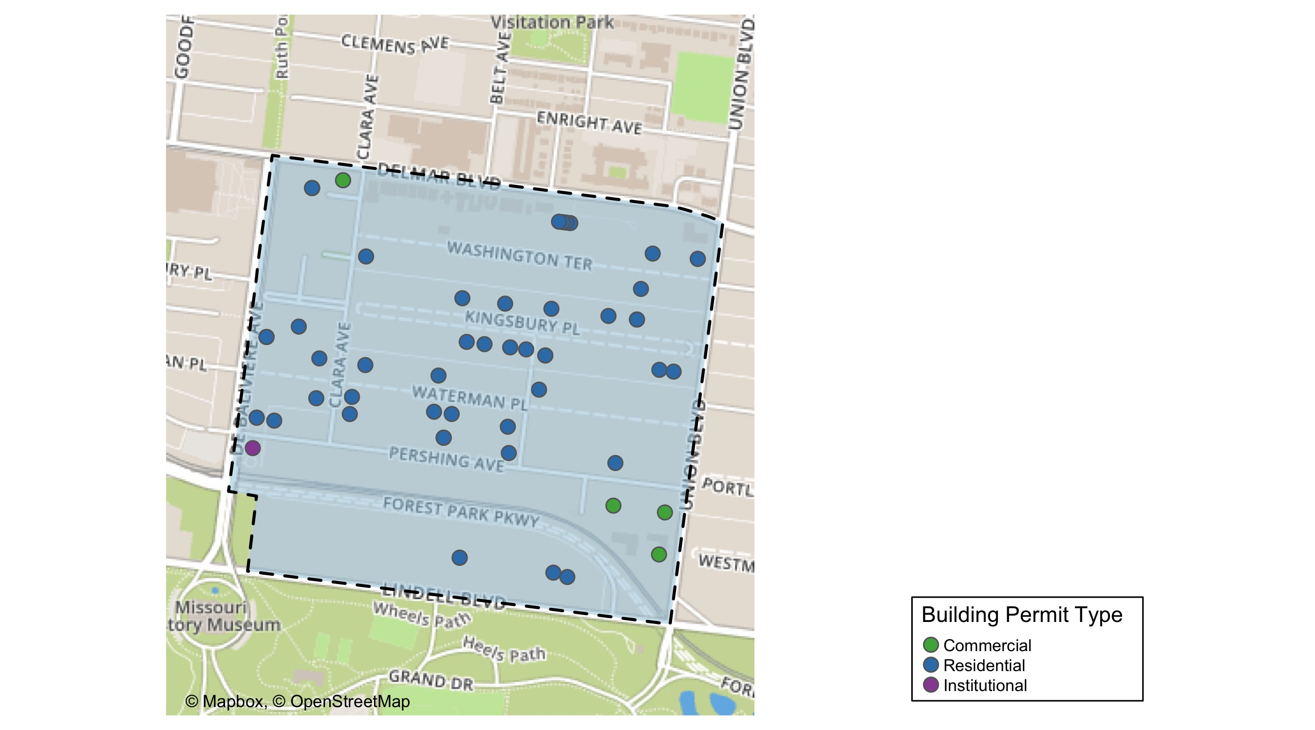
DeBaliviere Place

Slide 25
DeBaliviere Place
2020 | 2020 | 2020 | 2020
Permit Use | Average Cost | # of Permits | Total Value of Permits
Commercial | 10,756.0 | 5.0 | 53,780.0
Industrial | 0.0 | 0.0 | 0.0
Institutional | 4,200.0 | 2.0 | 8,400.0
Residential | 651,840.2 | 53.0 | 34,547,529.5
2019 | 2019 | 2019 | 2019
Permit Use | Average Cost | # of Permits | Total Value of Permits
Commercial | 12,500.0 | 2.0 | 25,000.0
Industrial | 0.0 | 0.0 | 0.0
Institutional | 51,500.0 | 2.0 | 103,000.0
Residential | 52,407.3 | 52.0 | 2,725,180.0

Slide 26
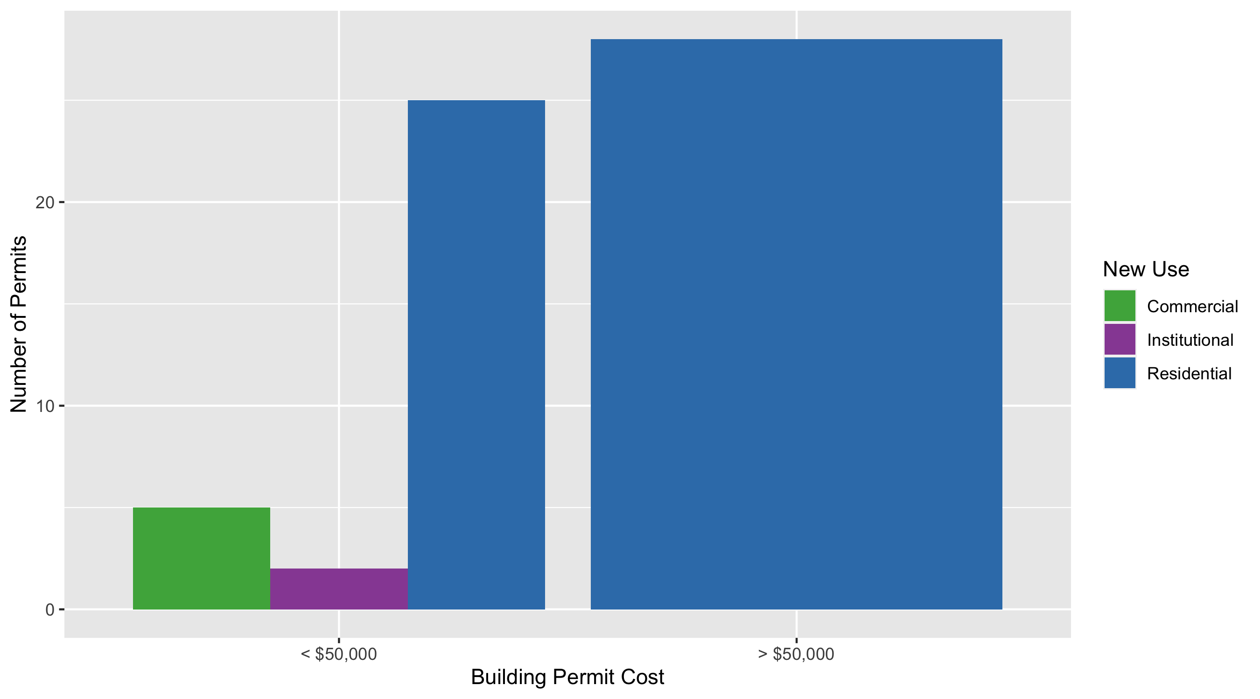
DeBaliviere Place Permit Cost Breakdown

Slide 27
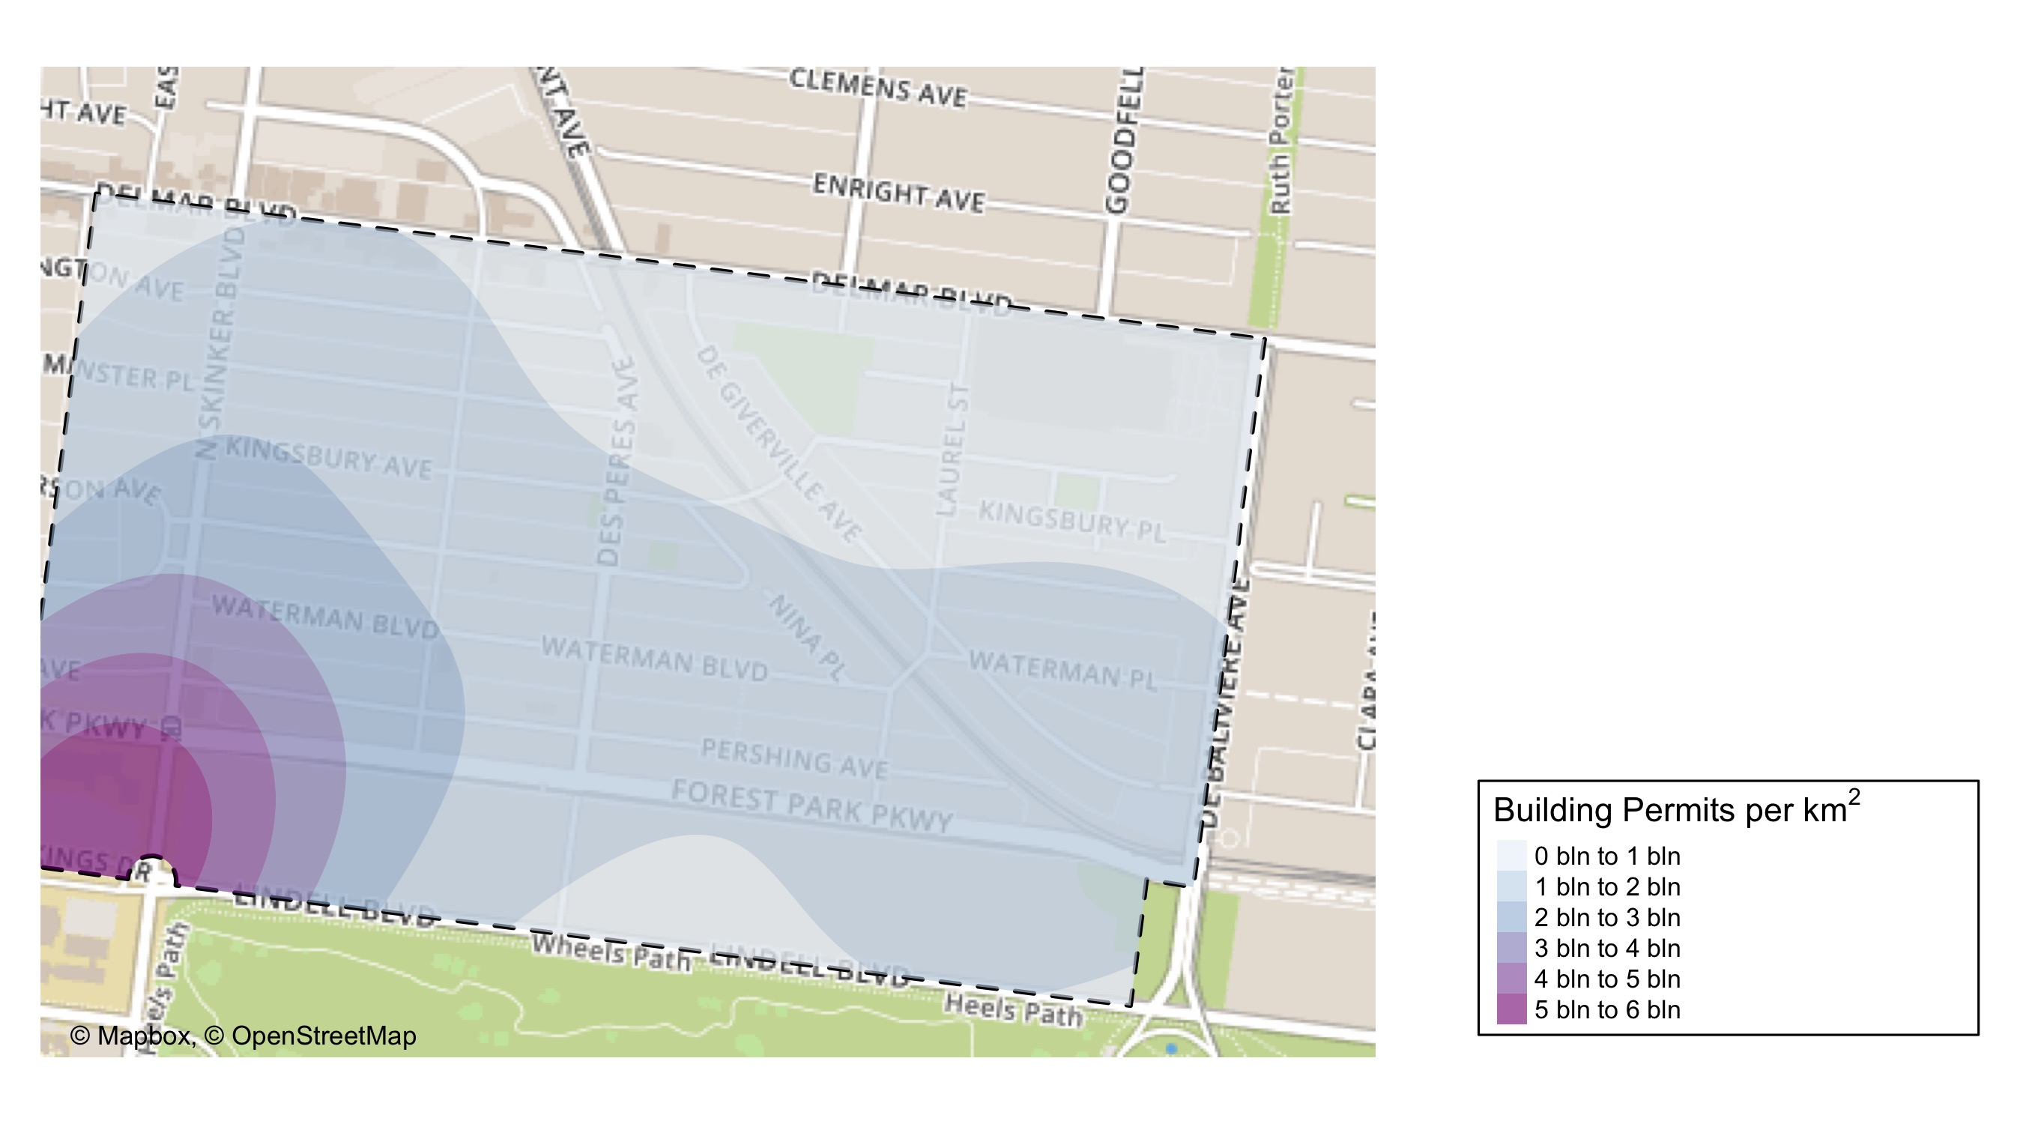
Skinker DeBaliviere: Crime Density Map

Slide 28
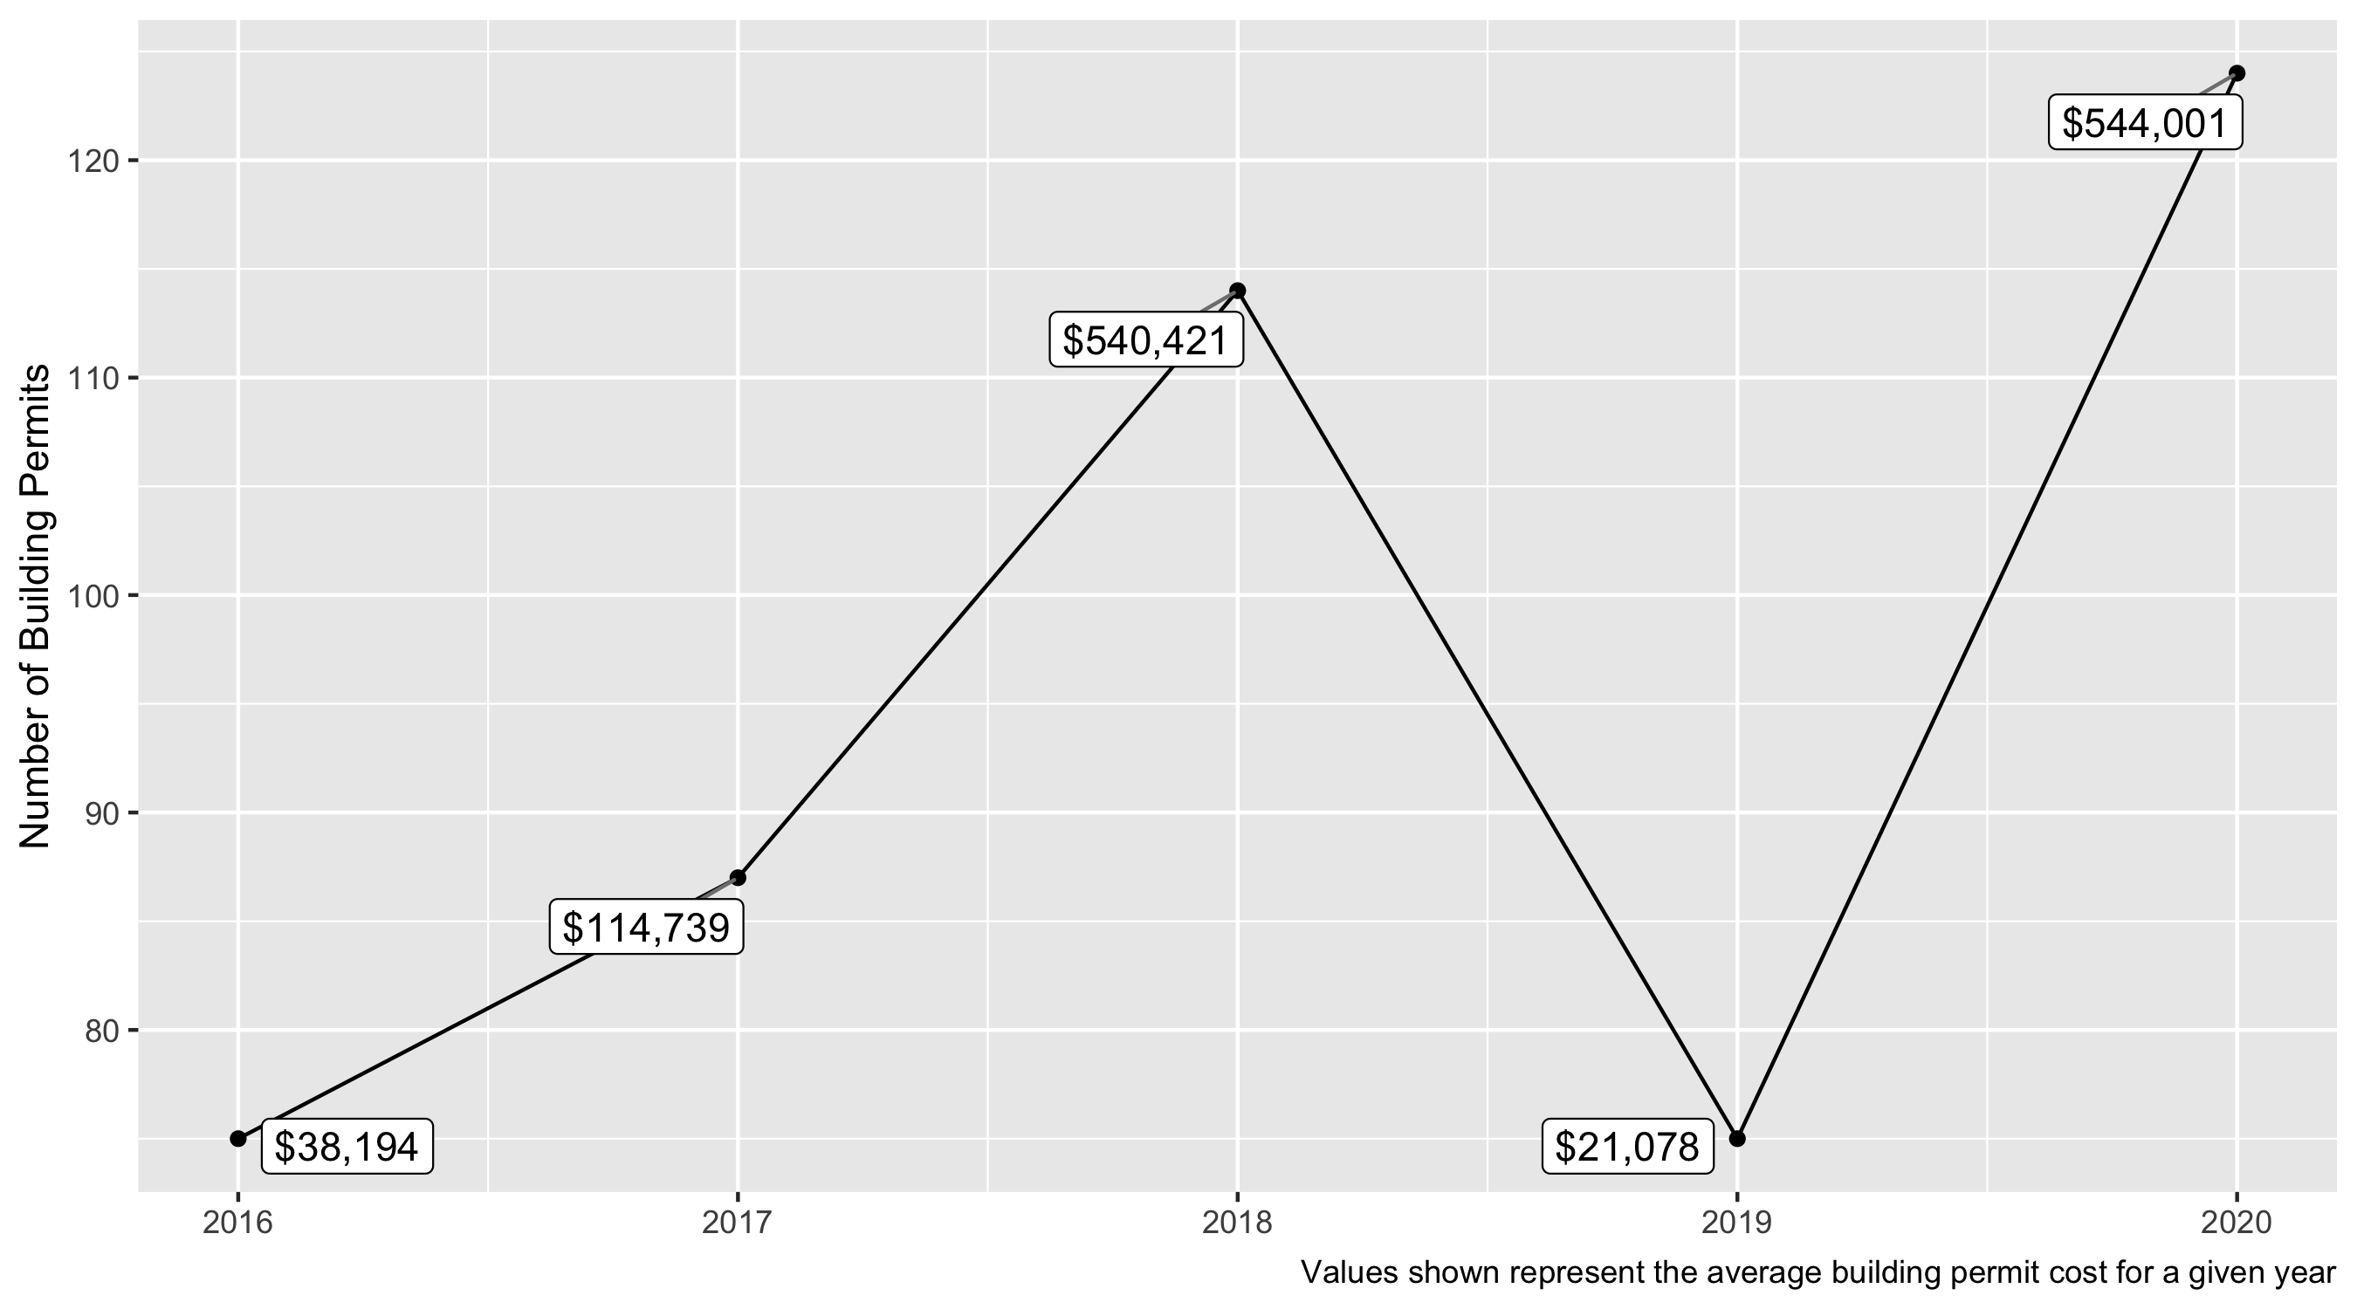
Skinker DeBaliviere 5 Year Analysis

Slide 29
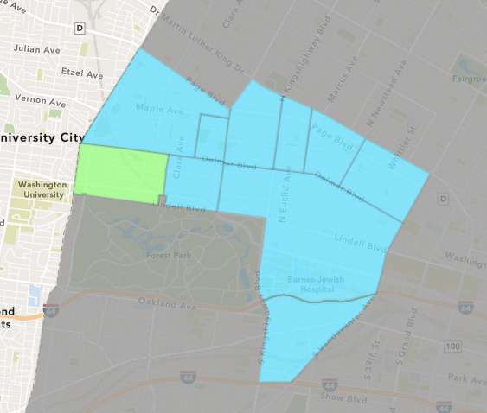
Skinker DeBaliviere
2020 Neighborhood Cost Breakdown
Mean: $544,001
Median: $15,000
Range: $150 - $33,603,927

Slide 30
Skinker DeBaliviere: Summary Notes
123 building permits in 2020
-28.49% change compared to 2019 (172 total building permits)
$2,691,675: Average building permit cost in 2020
1132.41% change compared to 2019 ($218,408)

Slide 31
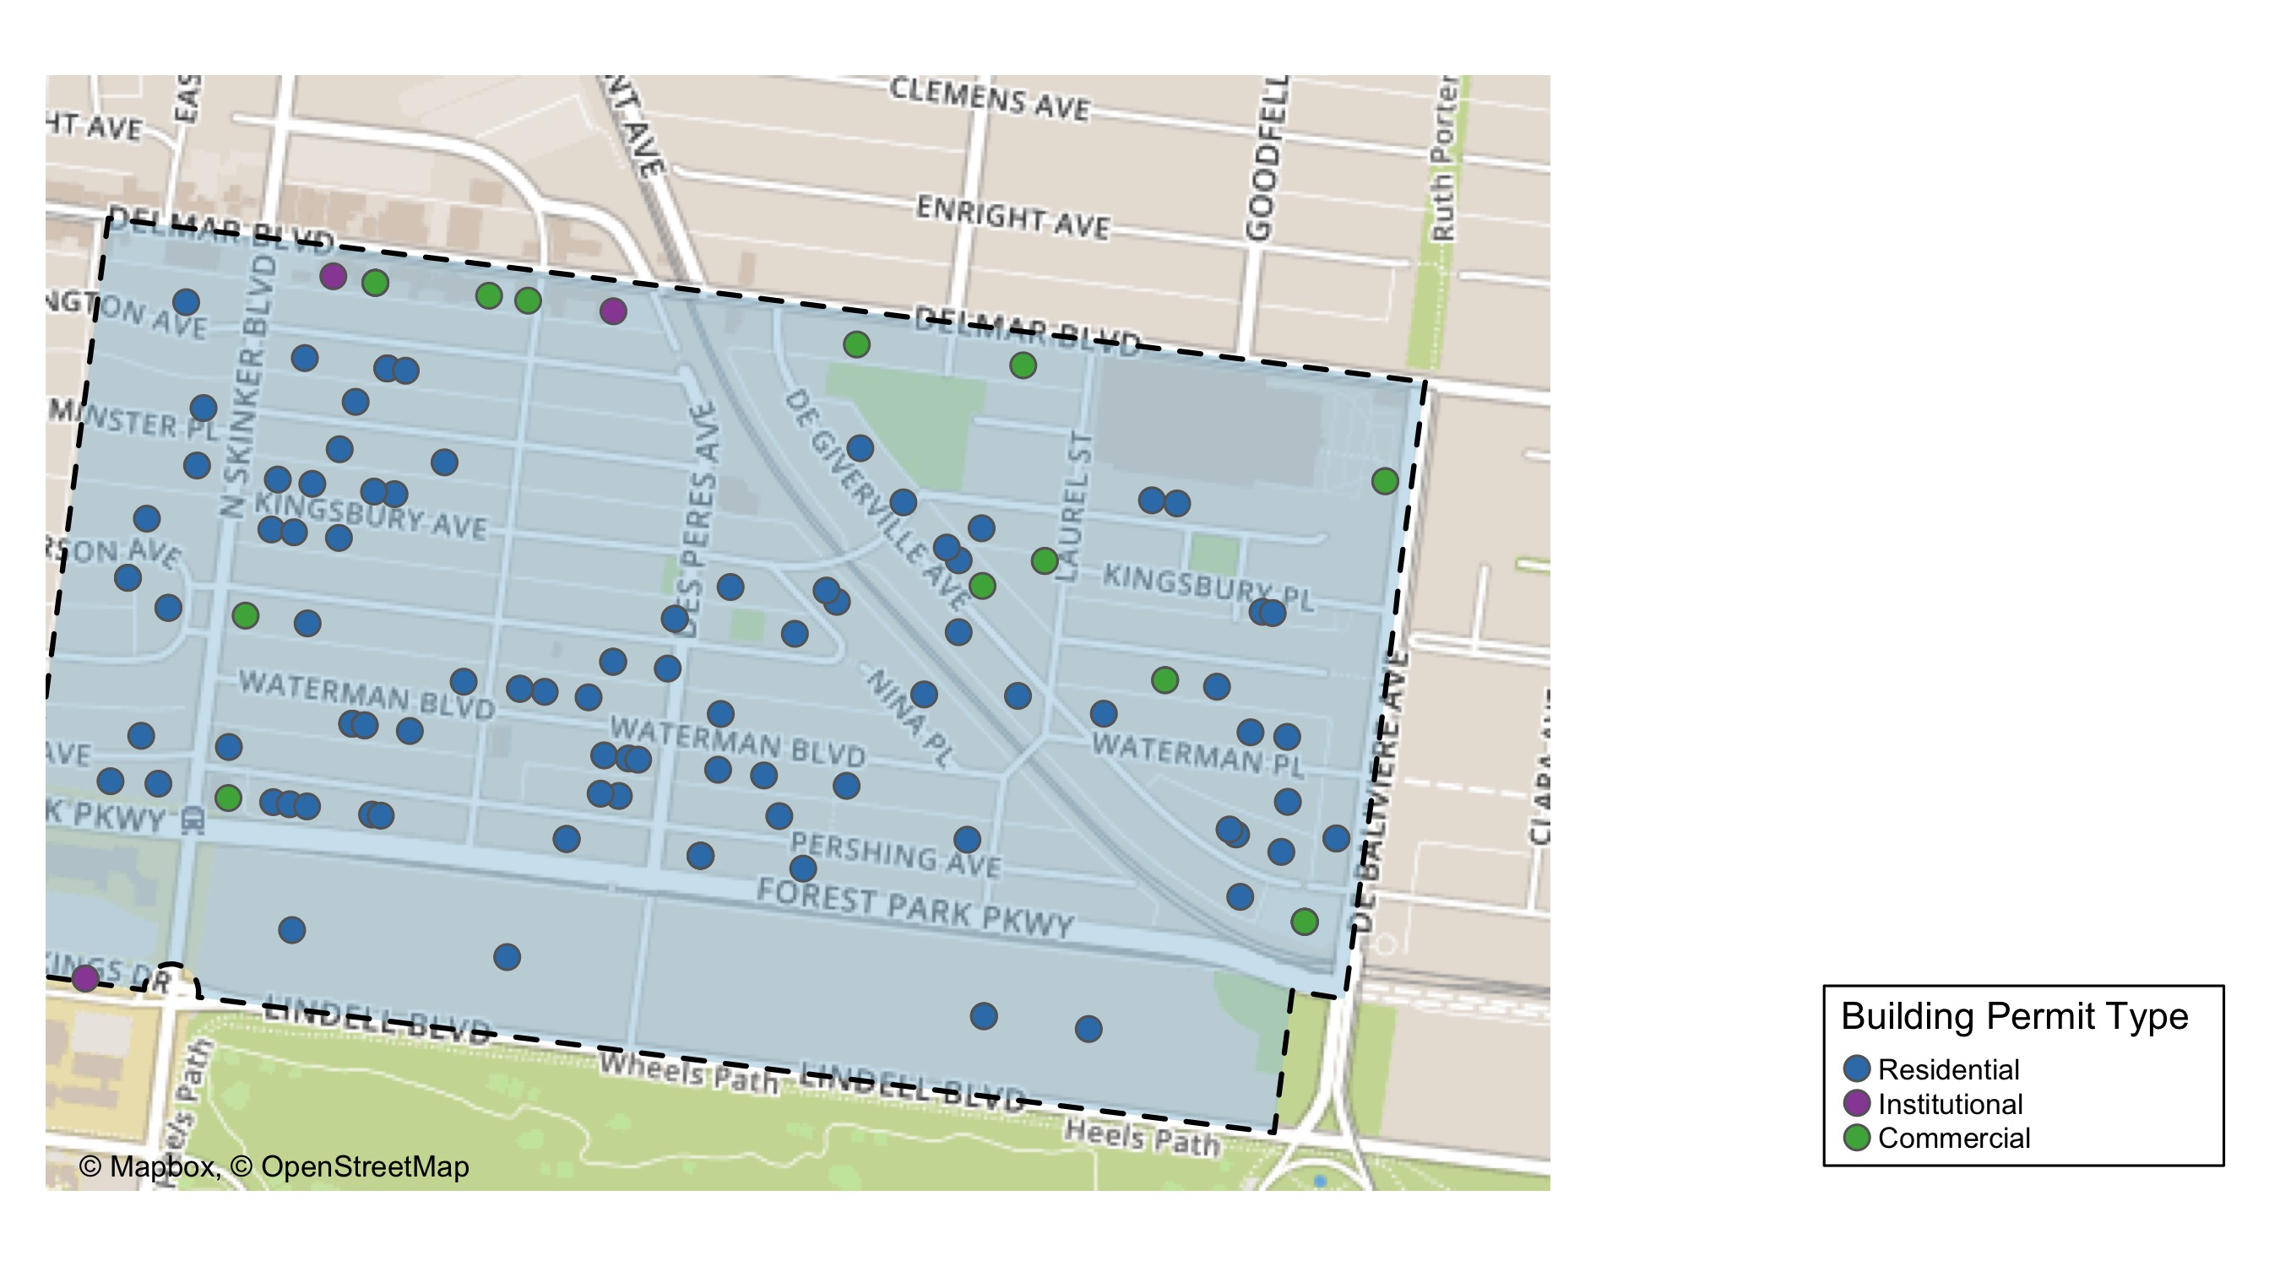
Skinker DeBaliviere

Slide 32
Skinker DeBaliviere
2020 | 2020 | 2020 | 2020
Permit Use | Average Cost | # of Permits | Total Value of Permits
Commercial | 3,571,004.6 | 16.0 | 57,136,074.0
Industrial | 0.0 | 0.0 | 0.0
Institutional | 534,800.1 | 7.0 | 3,743,601.0
Residential | 65,113.4 | 101.0 | 6,576,452.0
2019 | 2019 | 2019 | 2019
Permit Use | Average Cost | # of Permits | Total Value of Permits
Commercial | 13,938.2 | 6.0 | 83,629.0
Industrial | 0.0 | 0.0 | 0.0
Institutional | 75,700.0 | 3.0 | 227,100.0
Residential | 19,244.3 | 66.0 | 1,270,125.0

Slide 33
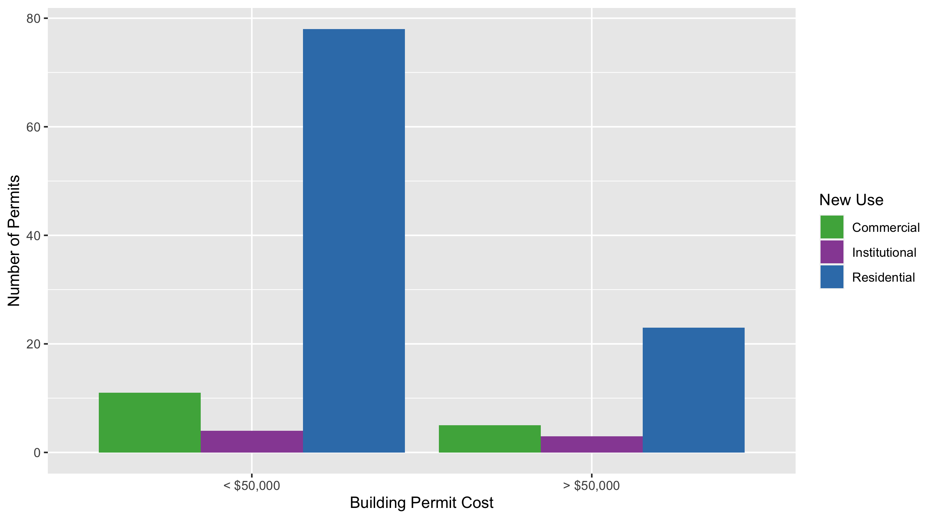
Skinker DeBaliviere Permit Cost Breakdown

Slide 34
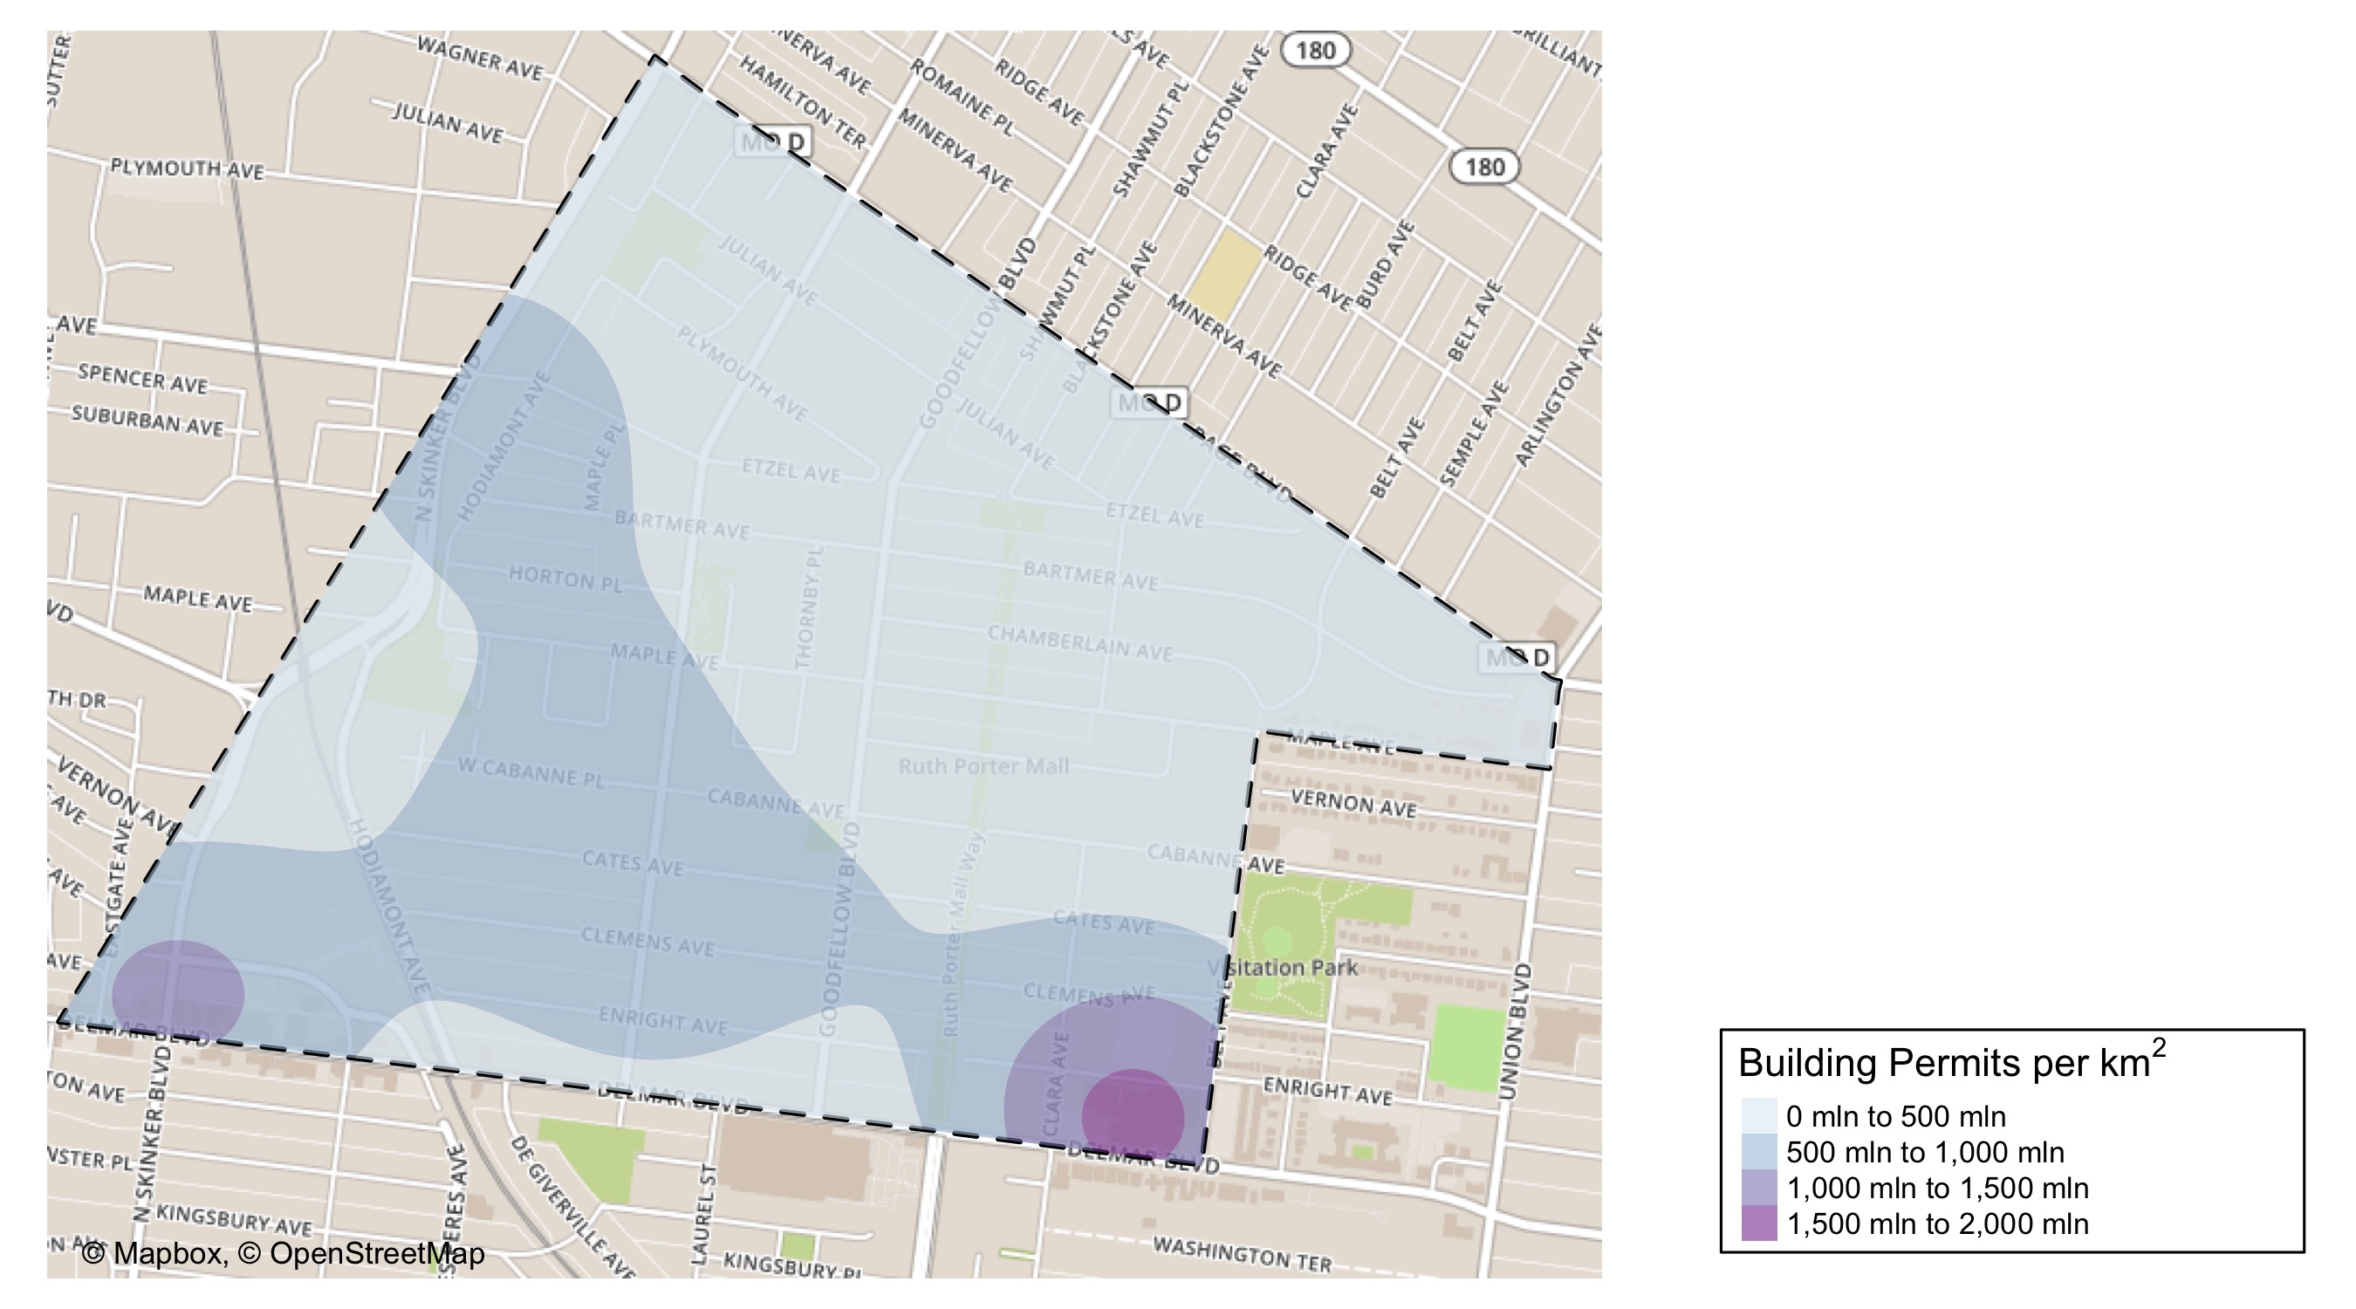
West End: Building Permit Density

Slide 35
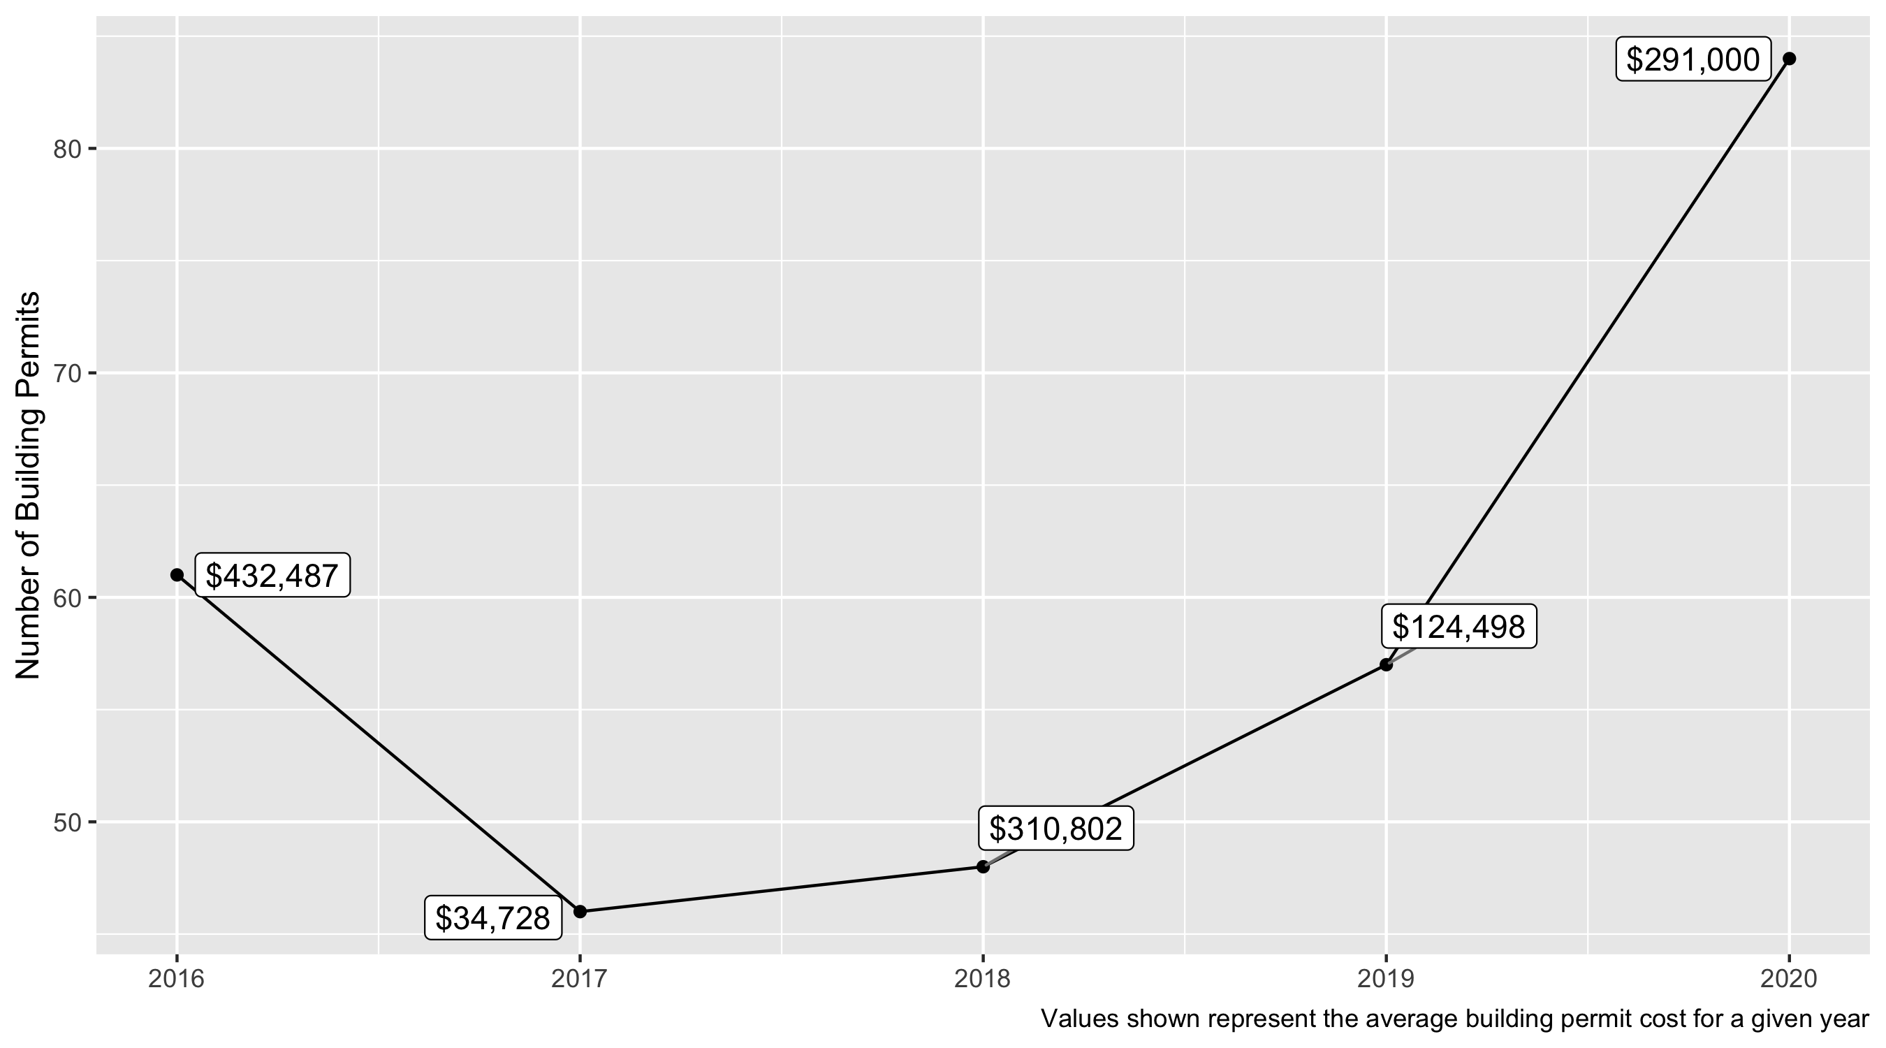
West End 5 Year Analysis

Slide 36
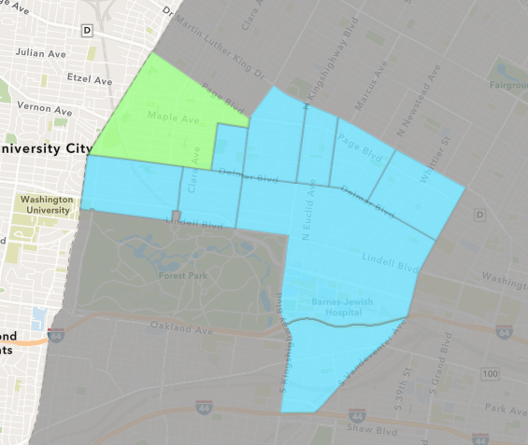
West End
2020 Neighborhood Cost Breakdown
Mean: $291,000
Median: $6,750
Range: $400 - $10,840,000

Slide 37
West End: Summary Notes
123 building permits in 2020
-28.49% change compared to 2019 (172 total building permits)
$2,691,675: Average building permit cost in 2020
1132.41% change compared to 2019 ($218,408)

Slide 38
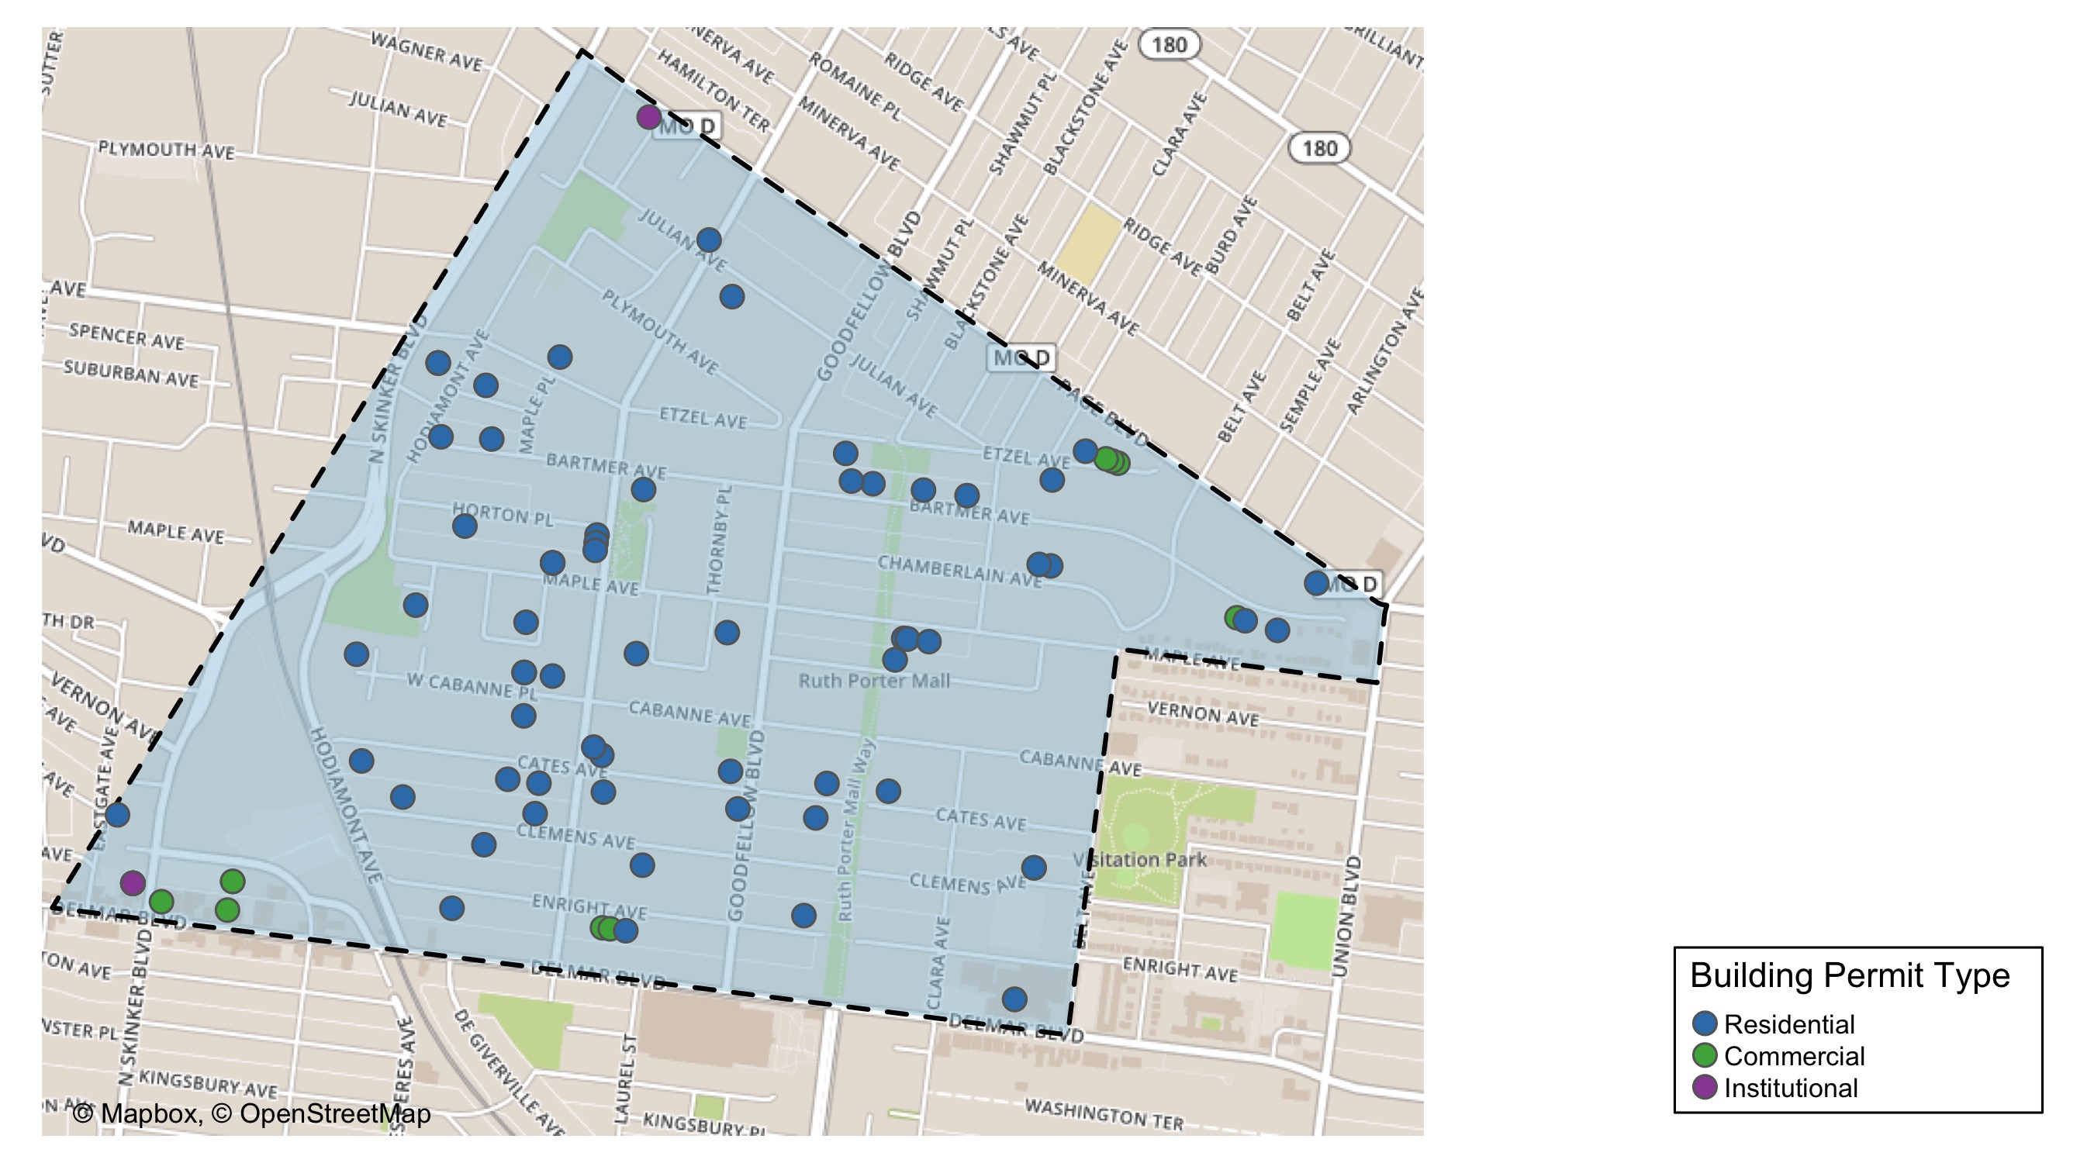
West End

Slide 39
West End
2020 | 2020 | 2020 | 2020
Permit Use | Average Cost | # of Permits | Total Value of Permits
Commercial | 48,391.4 | 14.0 | 677,480.0
Industrial | 0.0 | 0.0 | 0.0
Institutional | 3,182,011.7 | 3.0 | 9,546,035.0
Residential | 212,245.8 | 67.0 | 14,220,471.0
2019 | 2019 | 2019 | 2019
Permit Use | Average Cost | # of Permits | Total Value of Permits
Commercial | 191,700.0 | 9 | 1,725,300.0
Industrial | 30,000.0 | 1 | 30,000.0
Institutional | 350,820.2 | 8 | 2,806,562.0
Residential | 64,988.1 | 39 | 2,534,537.0

Slide 40
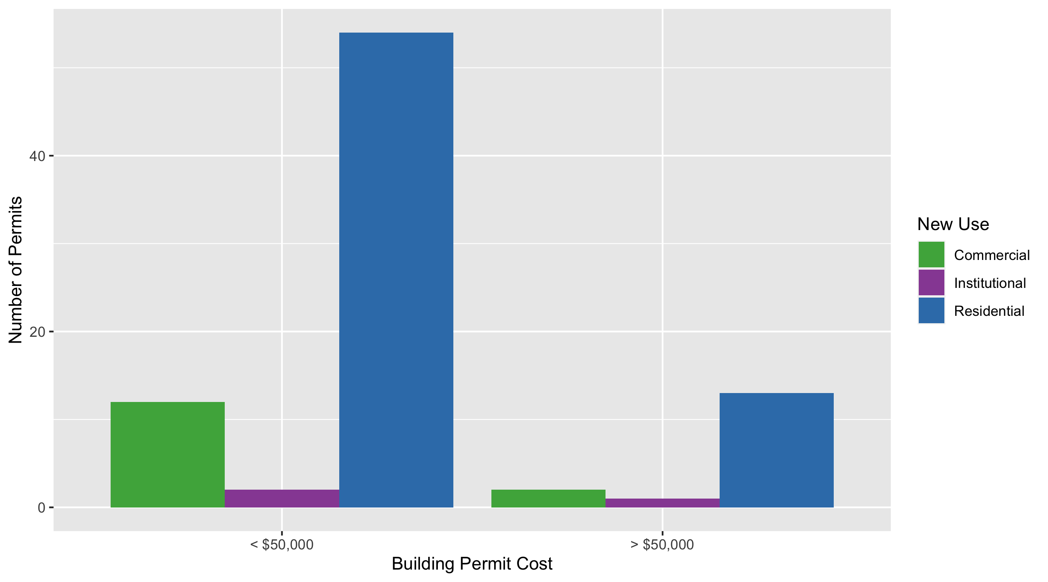
West End Permit Cost Breakdown

Slide 41
Visitation Park: Building Permit Density

Slide 42
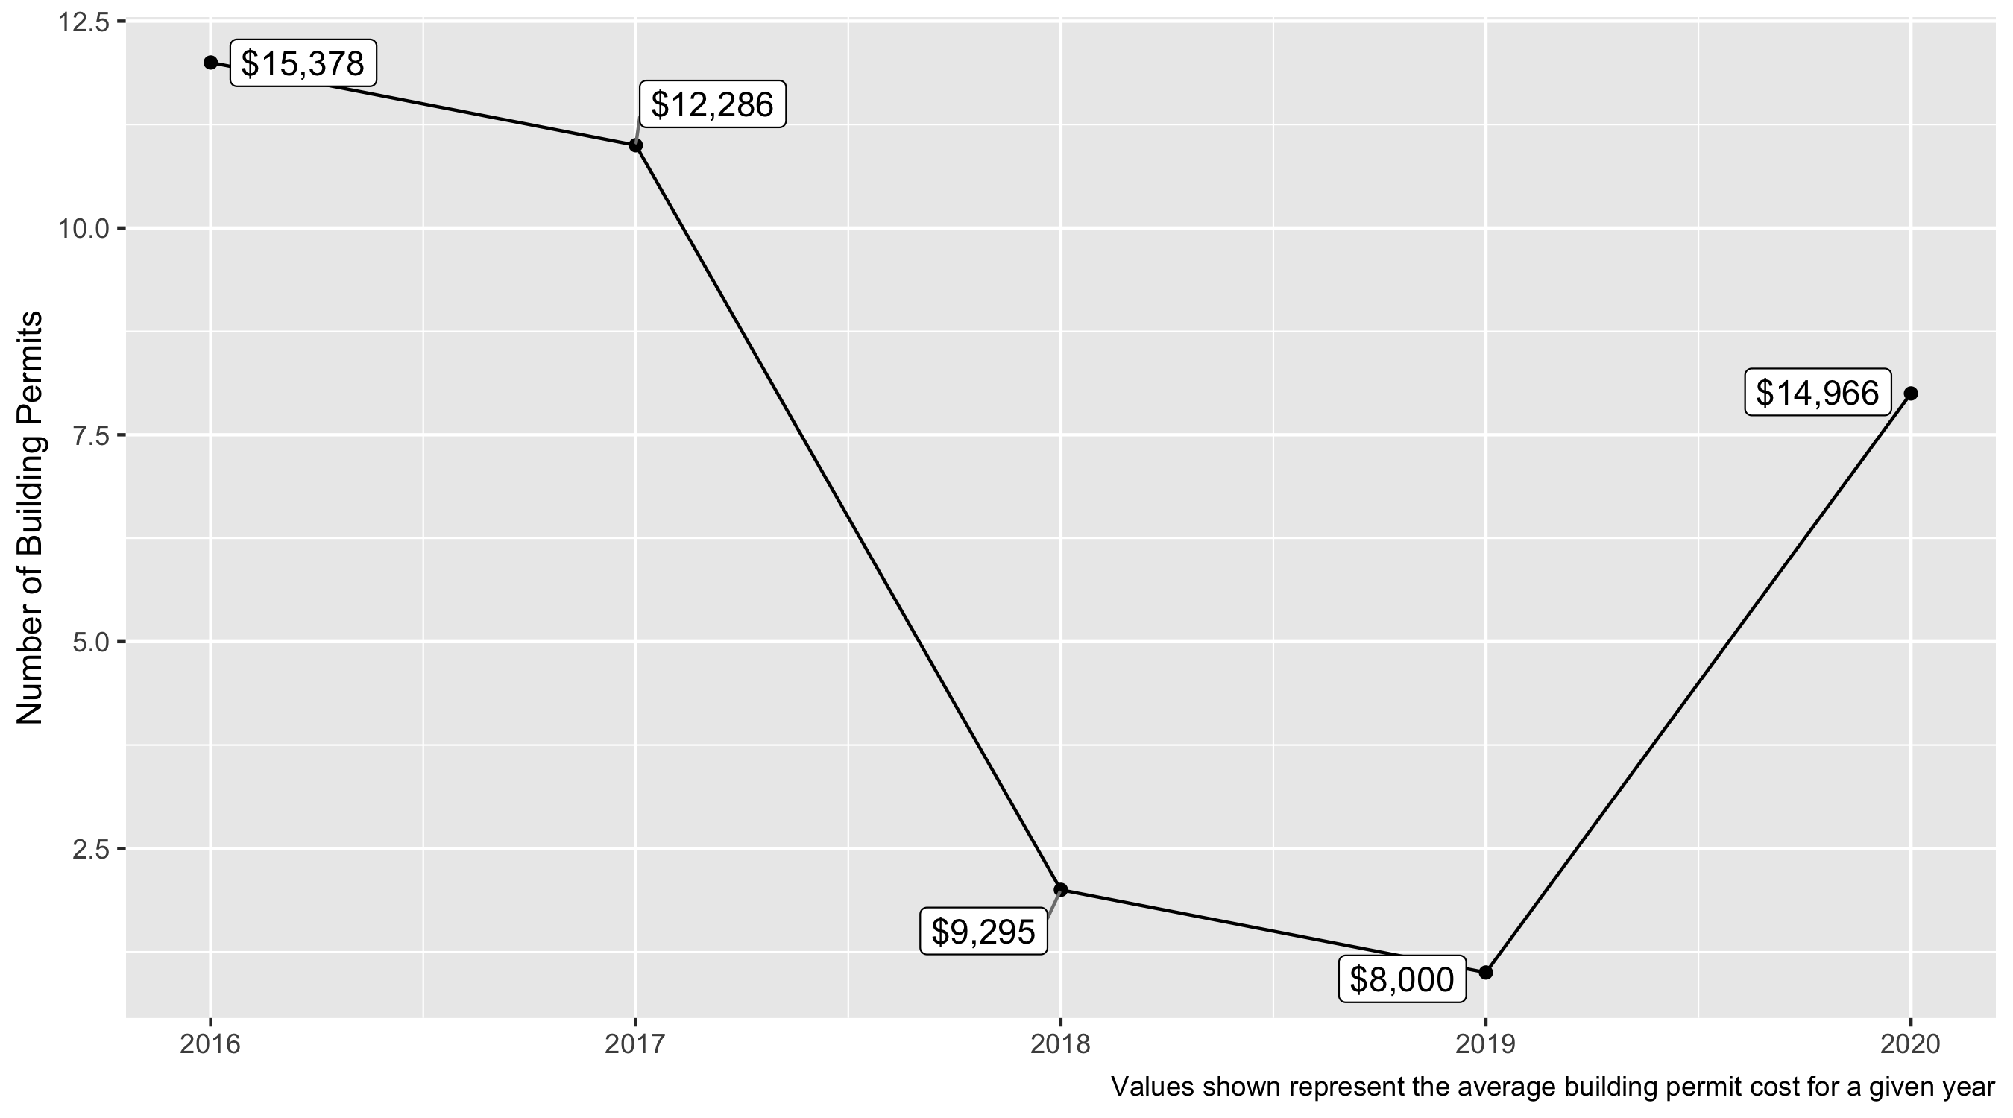
Visitation Park 5 Year Analysis

Slide 43
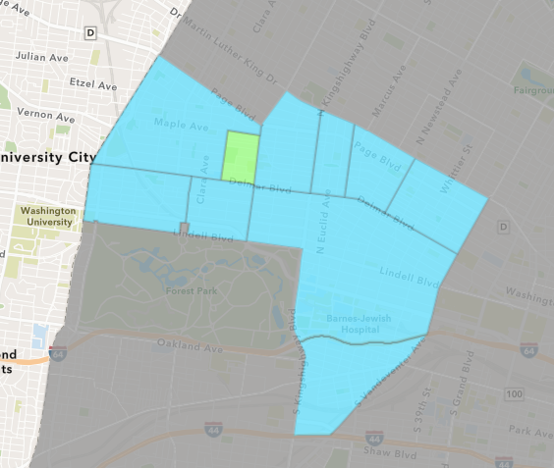
Visitation Park
2020 Neighborhood Cost Breakdown
Mean: $14,966
Median: $7,512
Range: $2,500 - $65,544

Slide 44
Visitation Park: Summary Notes
8 building permits in 2020
700.00% change compared to 2019 (1 total building permits)
$14,966: Average building permit cost in 2020
87.08% change compared to 2019 ($8,000)

Slide 45
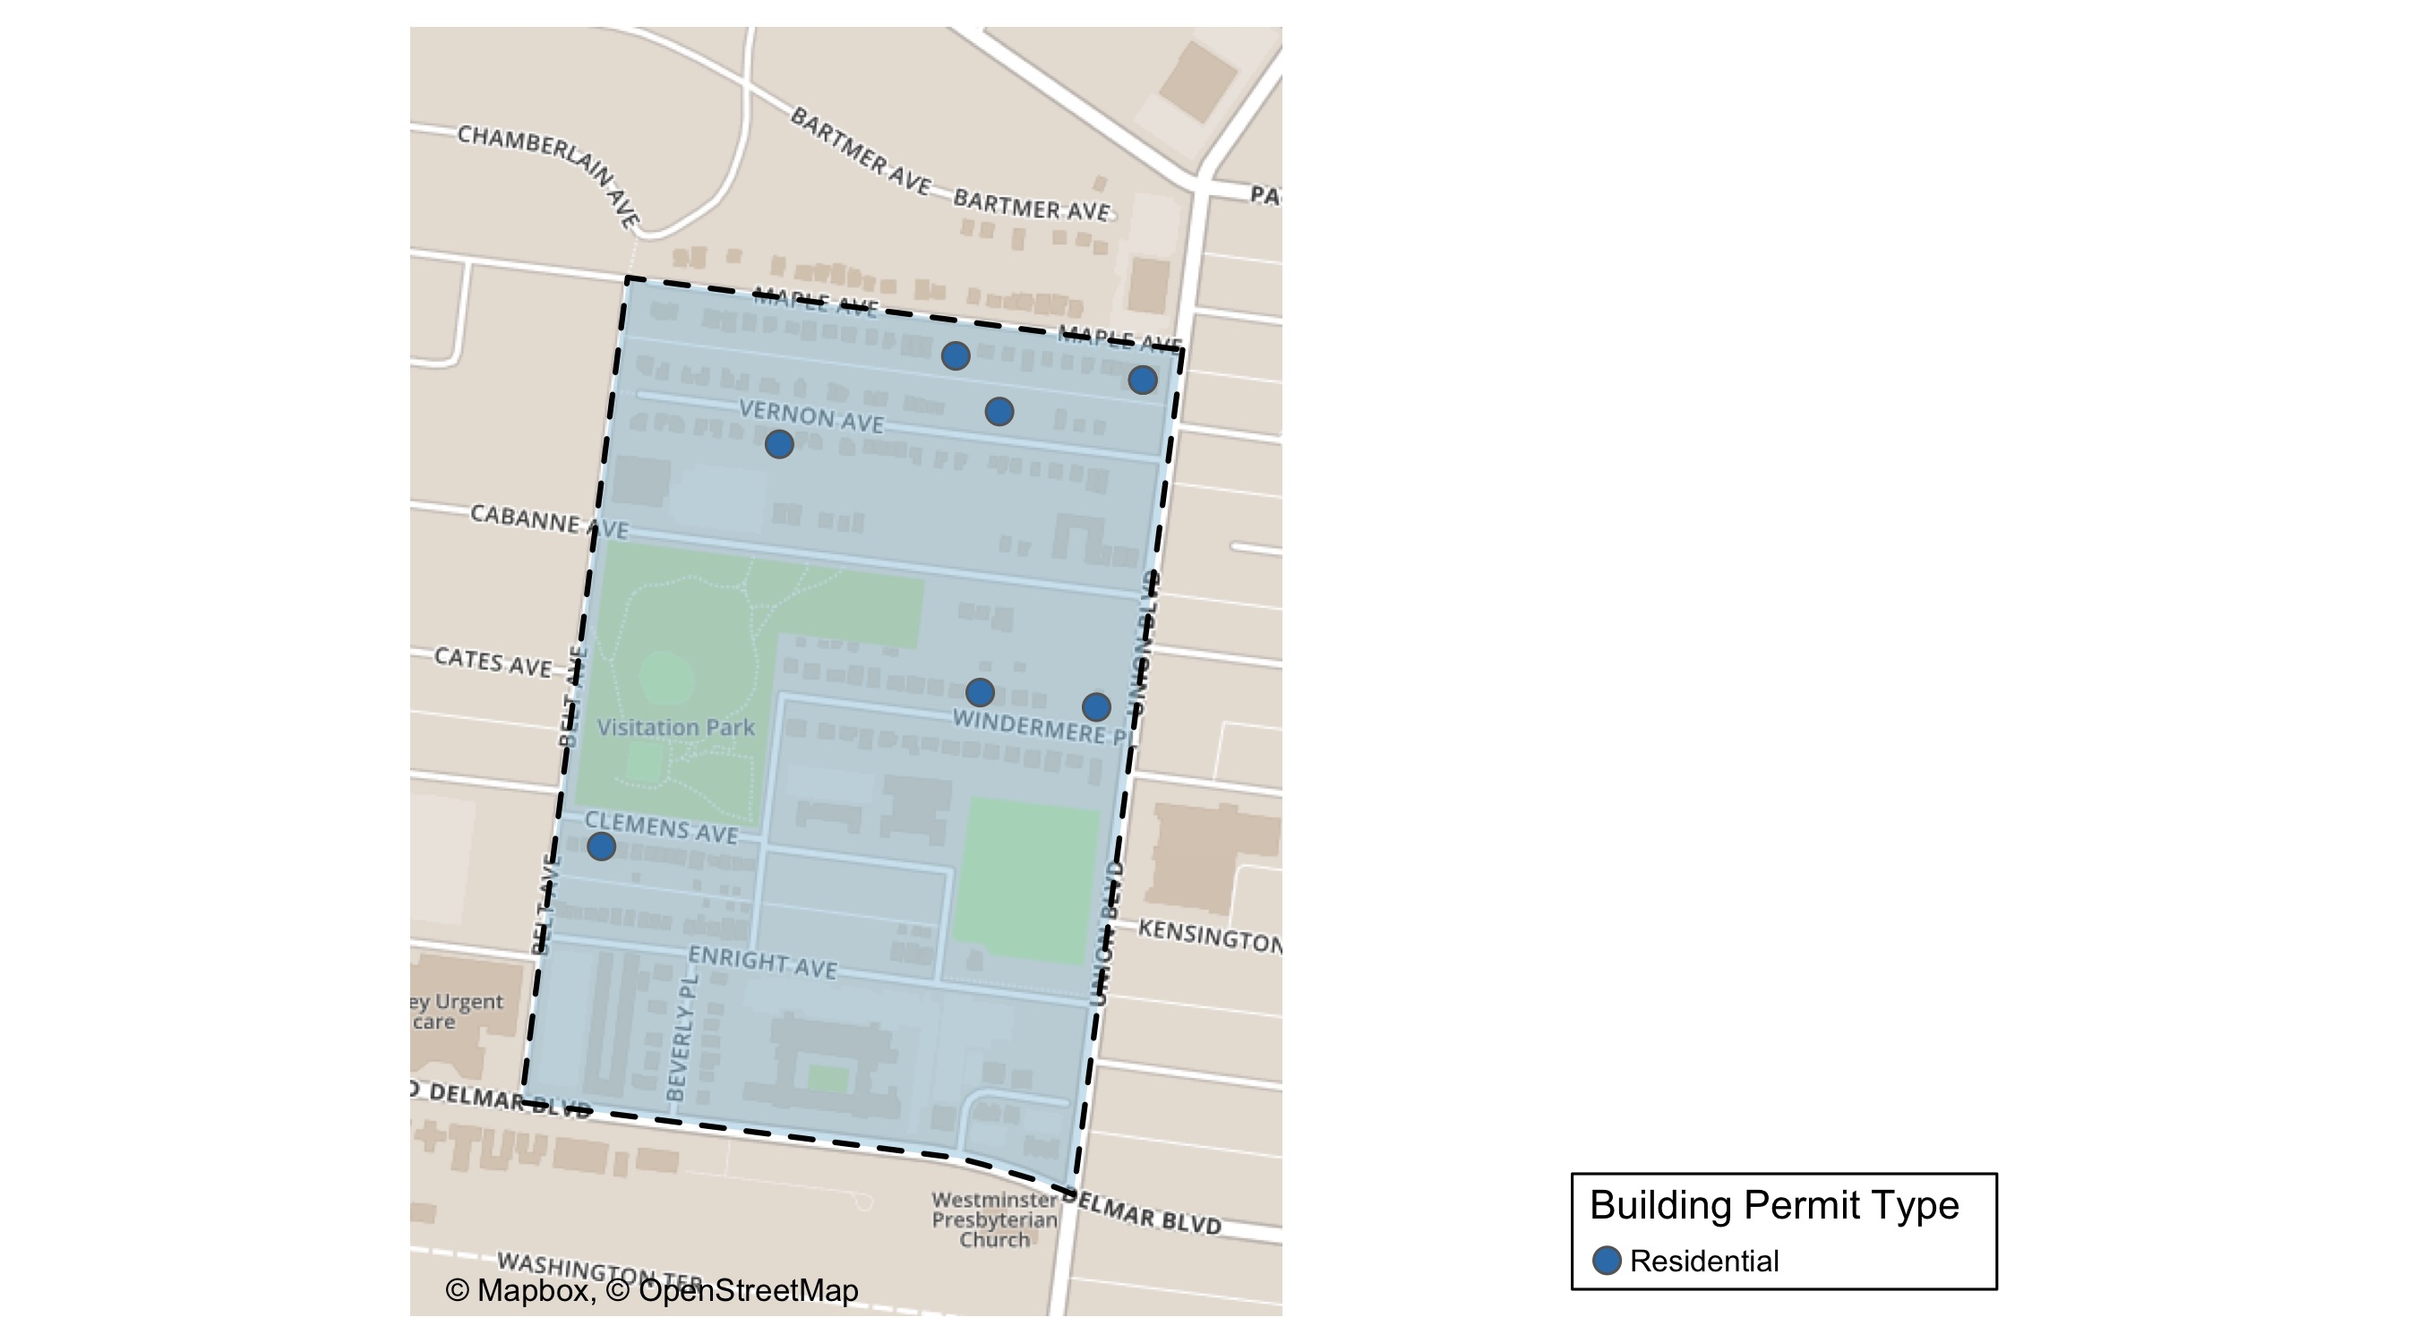
Visitation Park

Slide 46
Visitation Park
2020 | 2020 | 2020 | 2020
Permit Use | Average Cost | # of Permits | Total Value of Permits
Commercial | 0.0 | 0.0 | 0.0
Industrial | 0.0 | 0.0 | 0.0
Institutional | 0.0 | 0.0 | 0.0
Residential | 14,966.1 | 8.0 | 119,729.0
2019 | 2019 | 2019 | 2019
Permit Use | Average Cost | # of Permits | Total Value of Permits
Commercial | 0.0 | 0.0 | 0.0
Industrial | 0.0 | 0.0 | 0.0
Institutional | 0.0 | 0.0 | 0.0
Residential | 8,000.0 | 1.0 | 8,000.0

Slide 47
Visitation Park Individual Permit Breakdown
Owner | New Use | Cost | Address
JOHNSON, KIM M | Residential | 14,000.0 | 5347 VERNON AV
BOHANNON, ANTHONY | Residential | 7,250.0 | 5436 VERNON AV
MONTGOMERY, JUDY TRS | Residential | 6,261.0 | 13 WINDERMERE PL
WWREALESTATEINVEST LLC | Residential | 10,000.0 | 5304-08 MAPLE AV
DU MAINE, JESSICA J | Residential | 65,544.0 | 5470 CLEMENS PL
WWREALESTATEINVEST LLC | Residential | 6,400.0 | 5300-5304 MAPLE AV
BUTLER, BREONA | Residential | 7,774.0 | 5364 MAPLE AV
EVERETT, EDGAR III & | Residential | 2,500.0 | 1 WINDERMERE PL

Slide 48
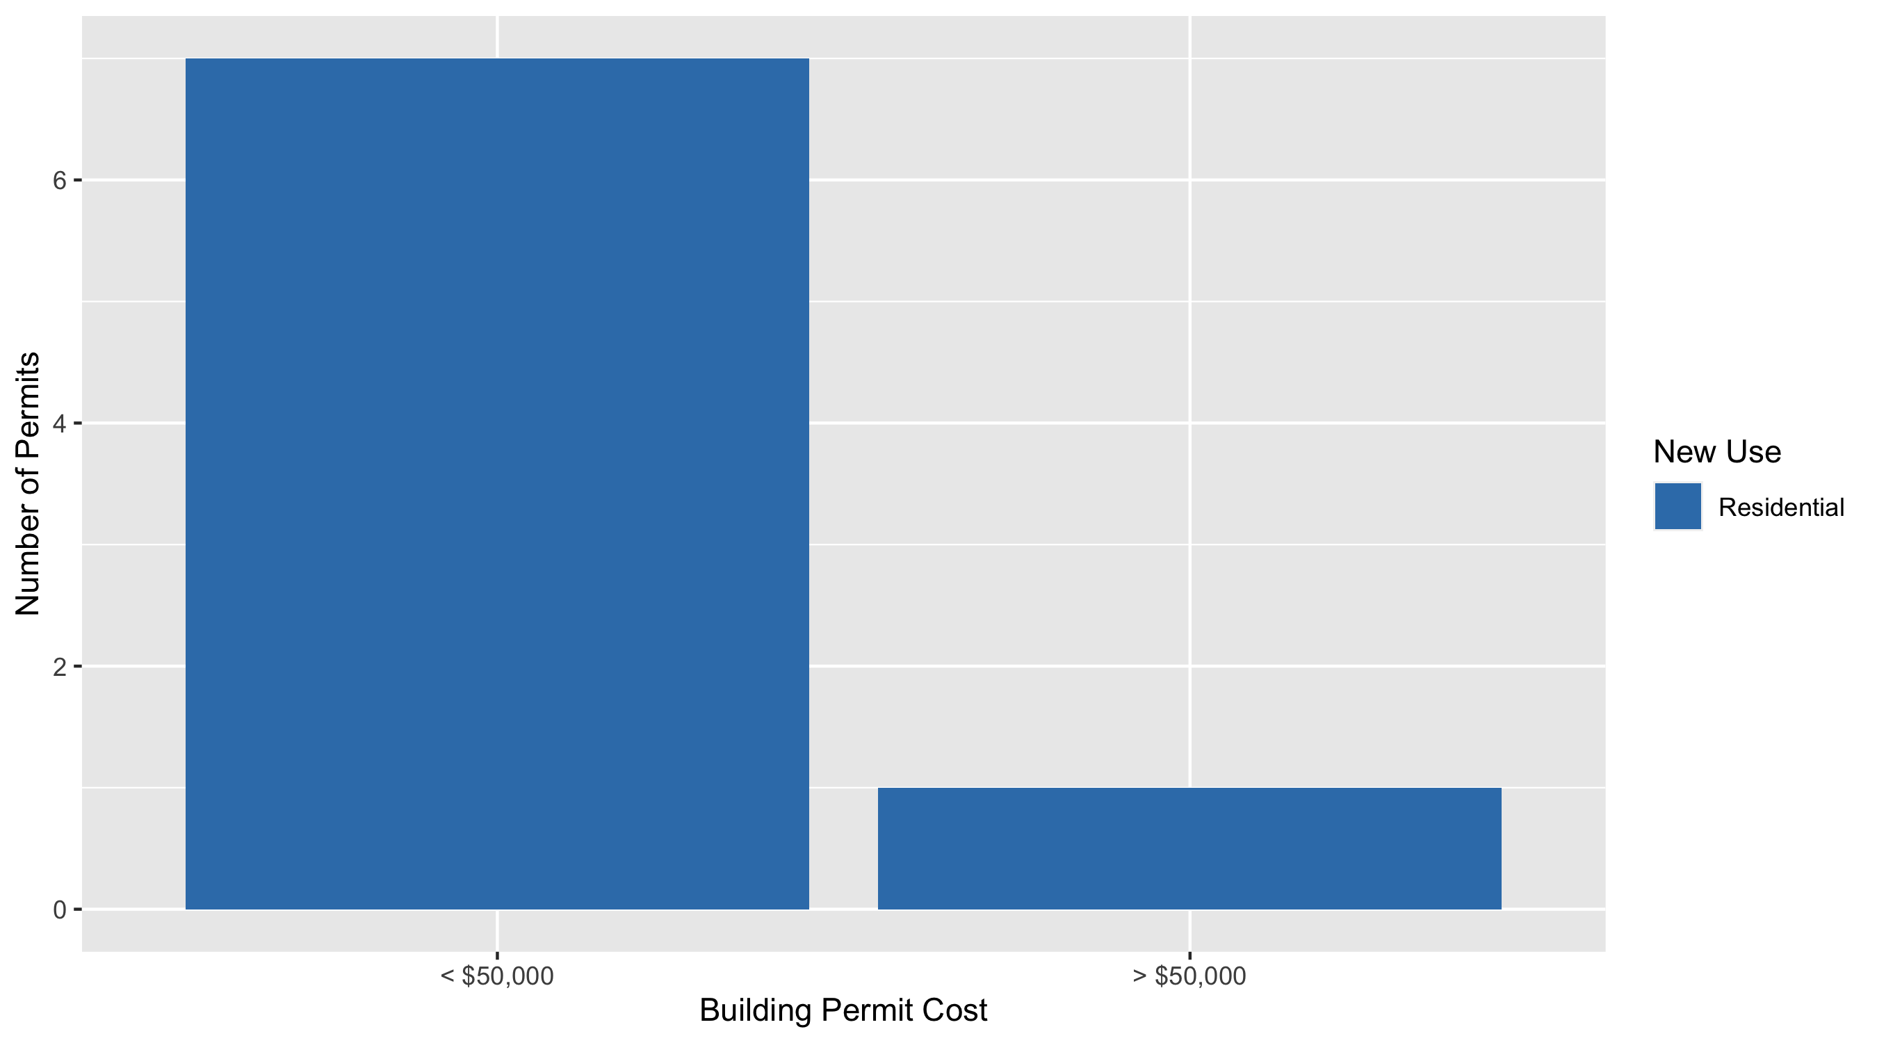
Visitation Park Permit Cost Breakdown

Slide 49
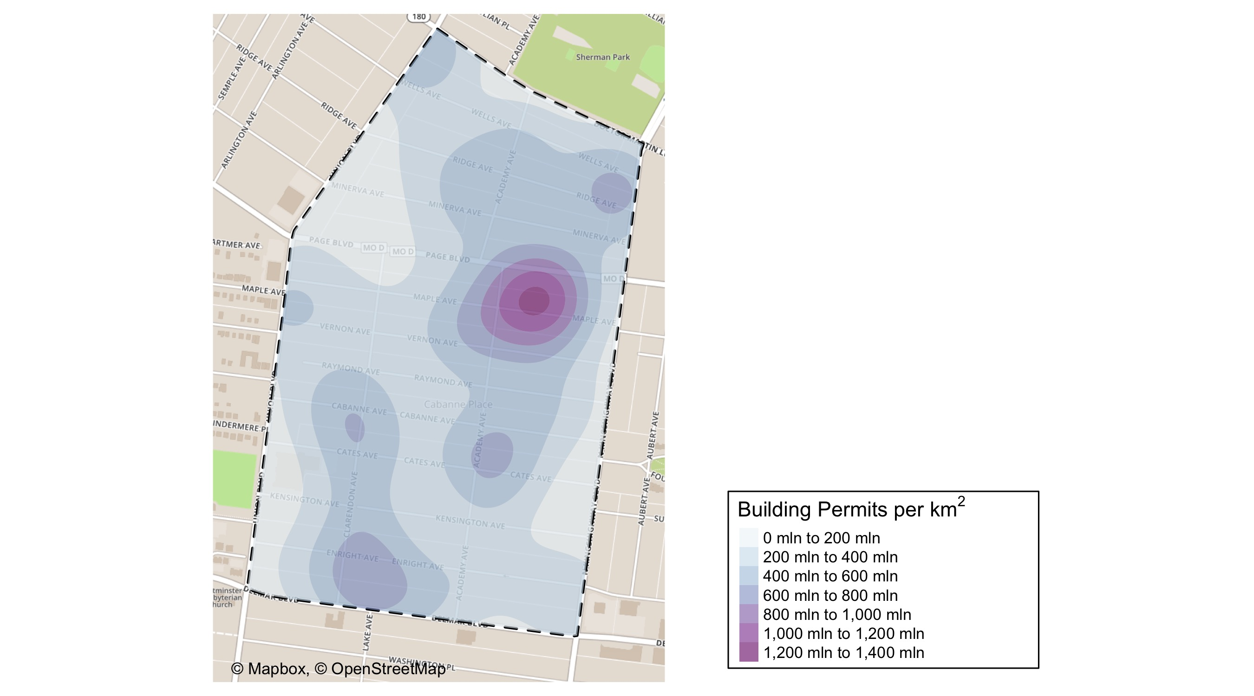
Academy: Building Permit Density Map

Slide 50
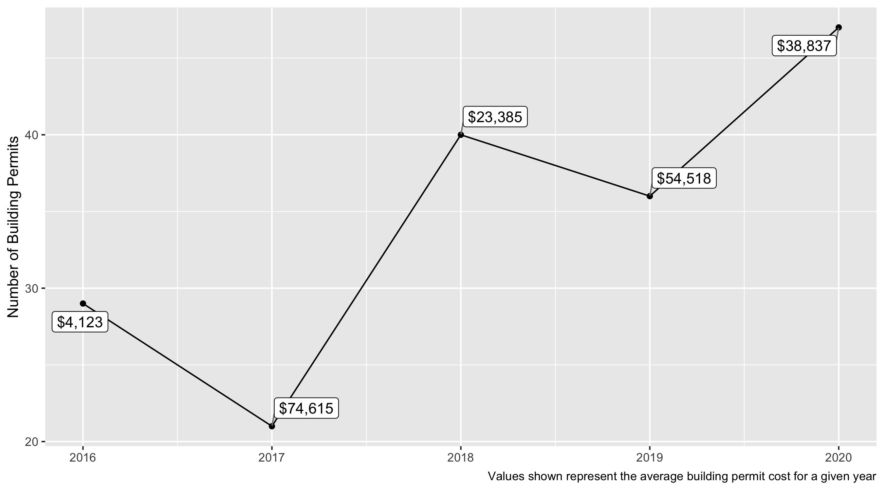
Academy 5 Year Analysis

Slide 51
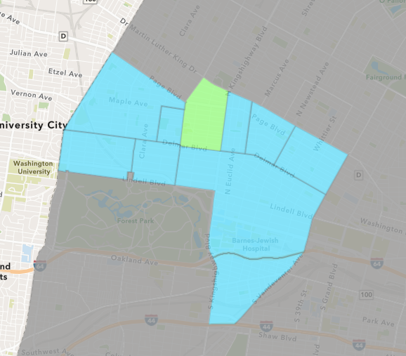
Academy
2020 Neighborhood Cost Breakdown
Mean: $38,837
Median: $5,000
Range: $200 - $200,000

Slide 52
Academy: Summary Notes
123 building permits in 2020
-28.49% change compared to 2019 (172 total building permits)
$2,691,675: Average building permit cost in 2020
1132.41% change compared to 2019 ($218,408)

Slide 53
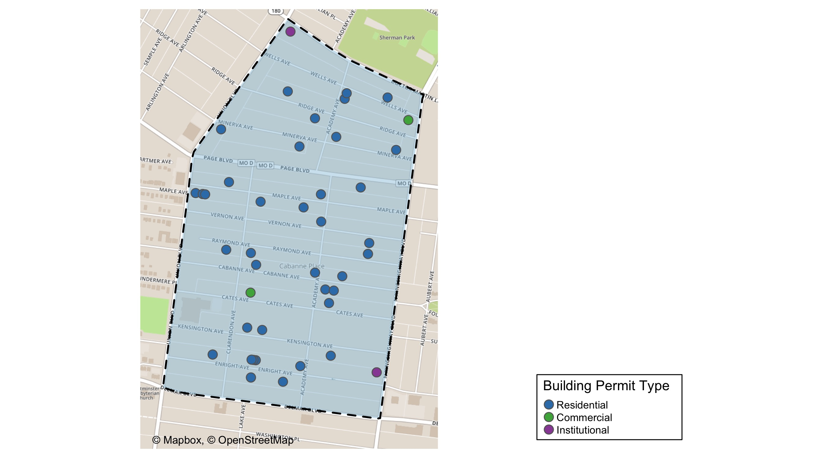
Academy

Slide 54
Academy
2020 | 2020 | 2020 | 2020
Permit Use | Average Cost | # of Permits | Total Value of Permits
Commercial | 12,500.0 | 2.0 | 25,000.0
Industrial | 0.0 | 0.0 | 0.0
Institutional | 36,833.3 | 3.0 | 110,500.0
Residential | 40,233.8 | 42.0 | 1,689,819.0
2019 | 2019 | 2019 | 2019
Permit Use | Average Cost | # of Permits | Total Value of Permits
Commercial | 2,950.0 | 3.0 | 8,850.0
Industrial | 0.0 | 0.0 | 0.0
Institutional | 102,333.3 | 3.0 | 307,000.0
Residential | 54,893.7 | 30.0 | 1,646,810.0

Slide 55
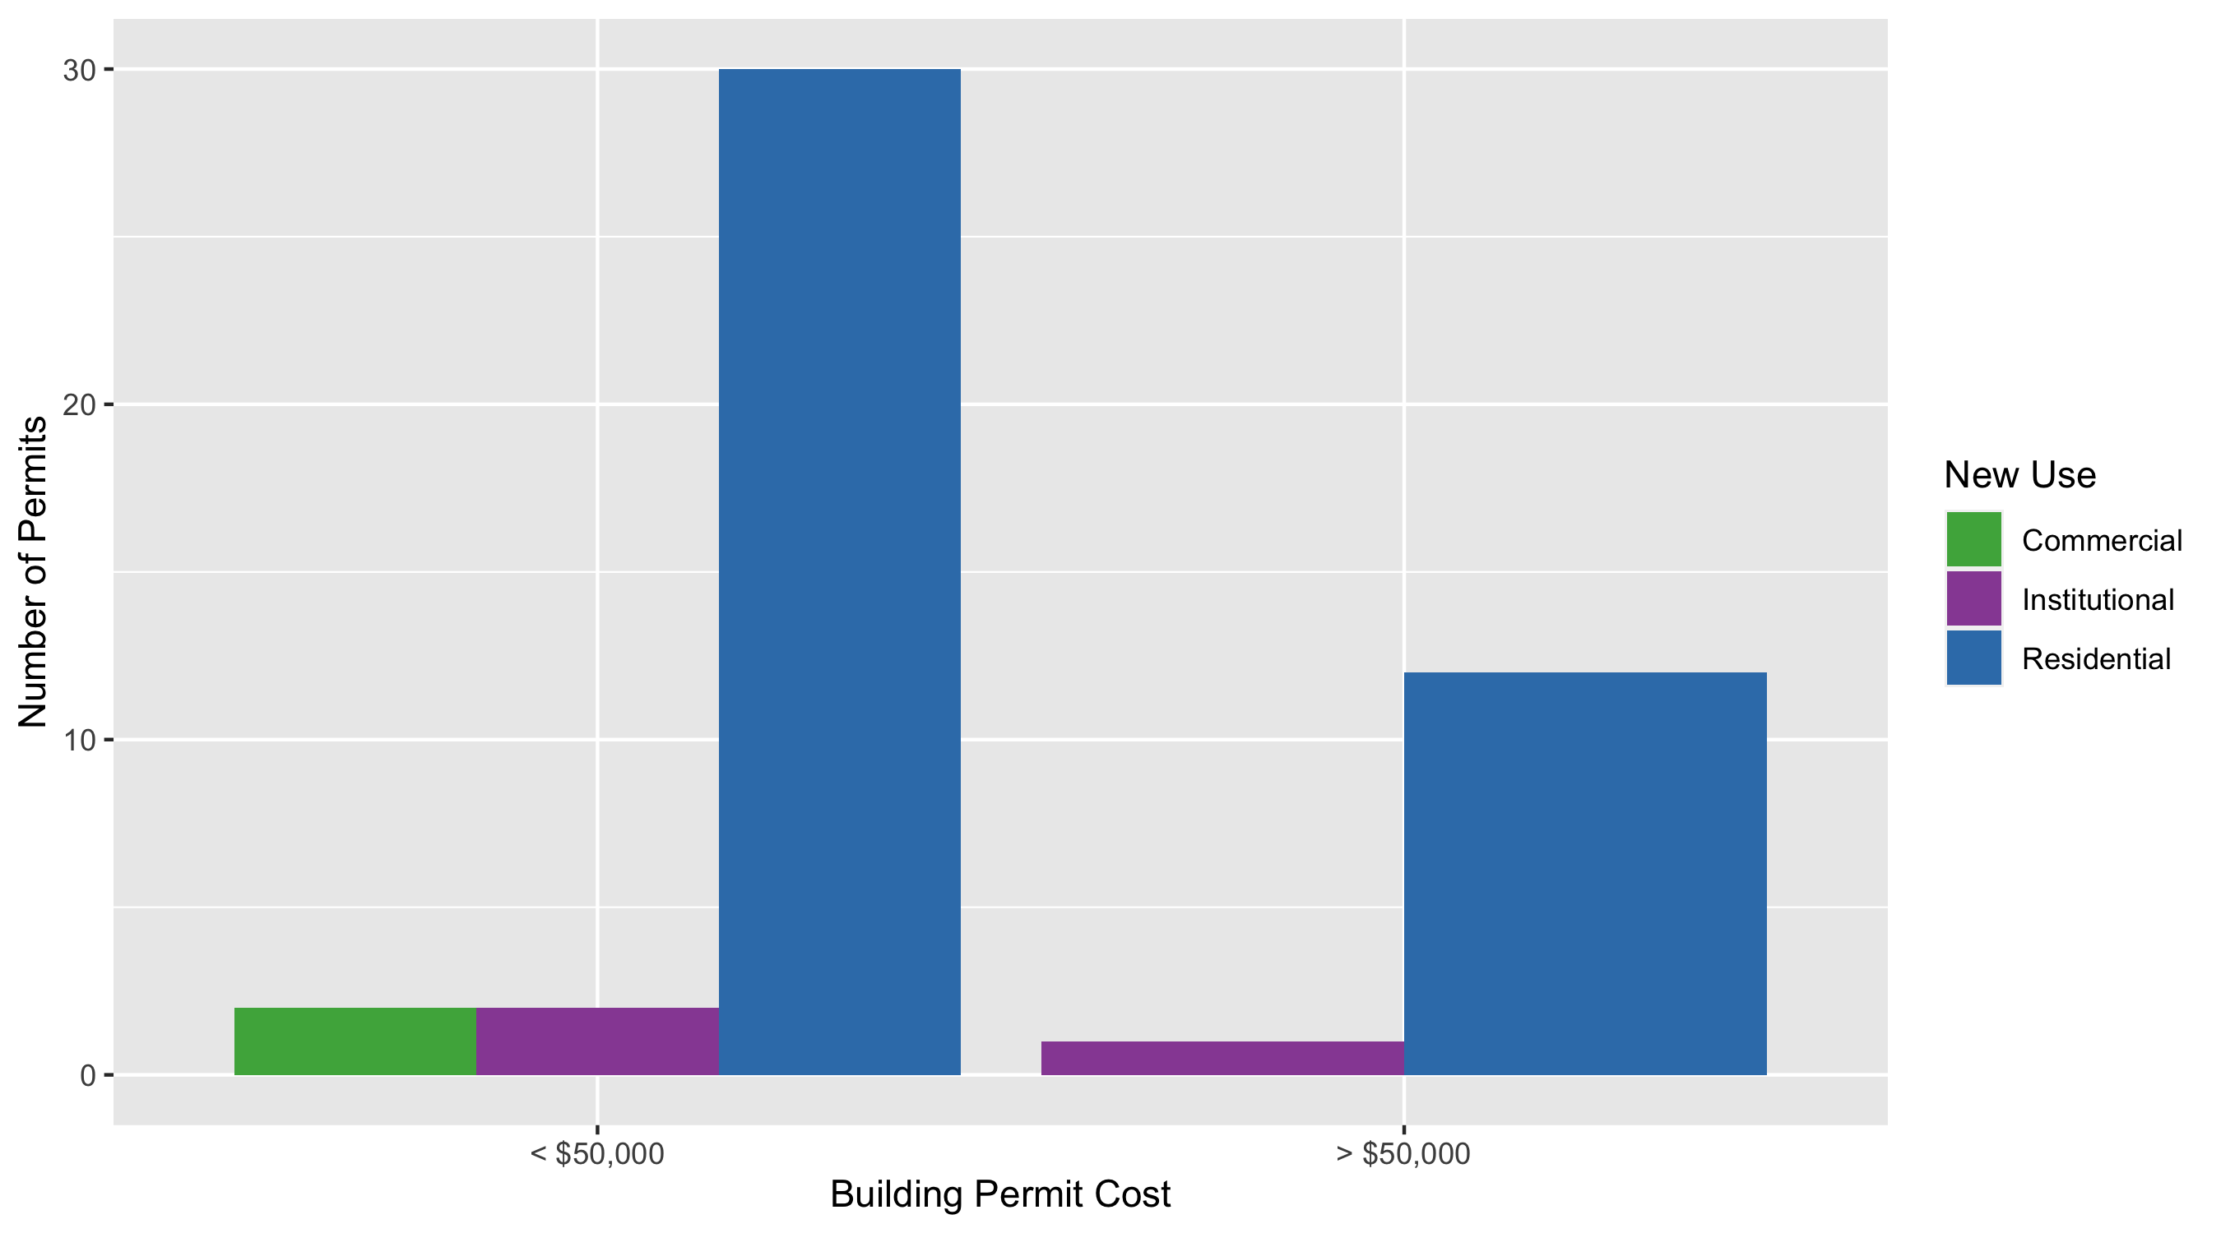
Academy Permit Cost Breakdown

Slide 56
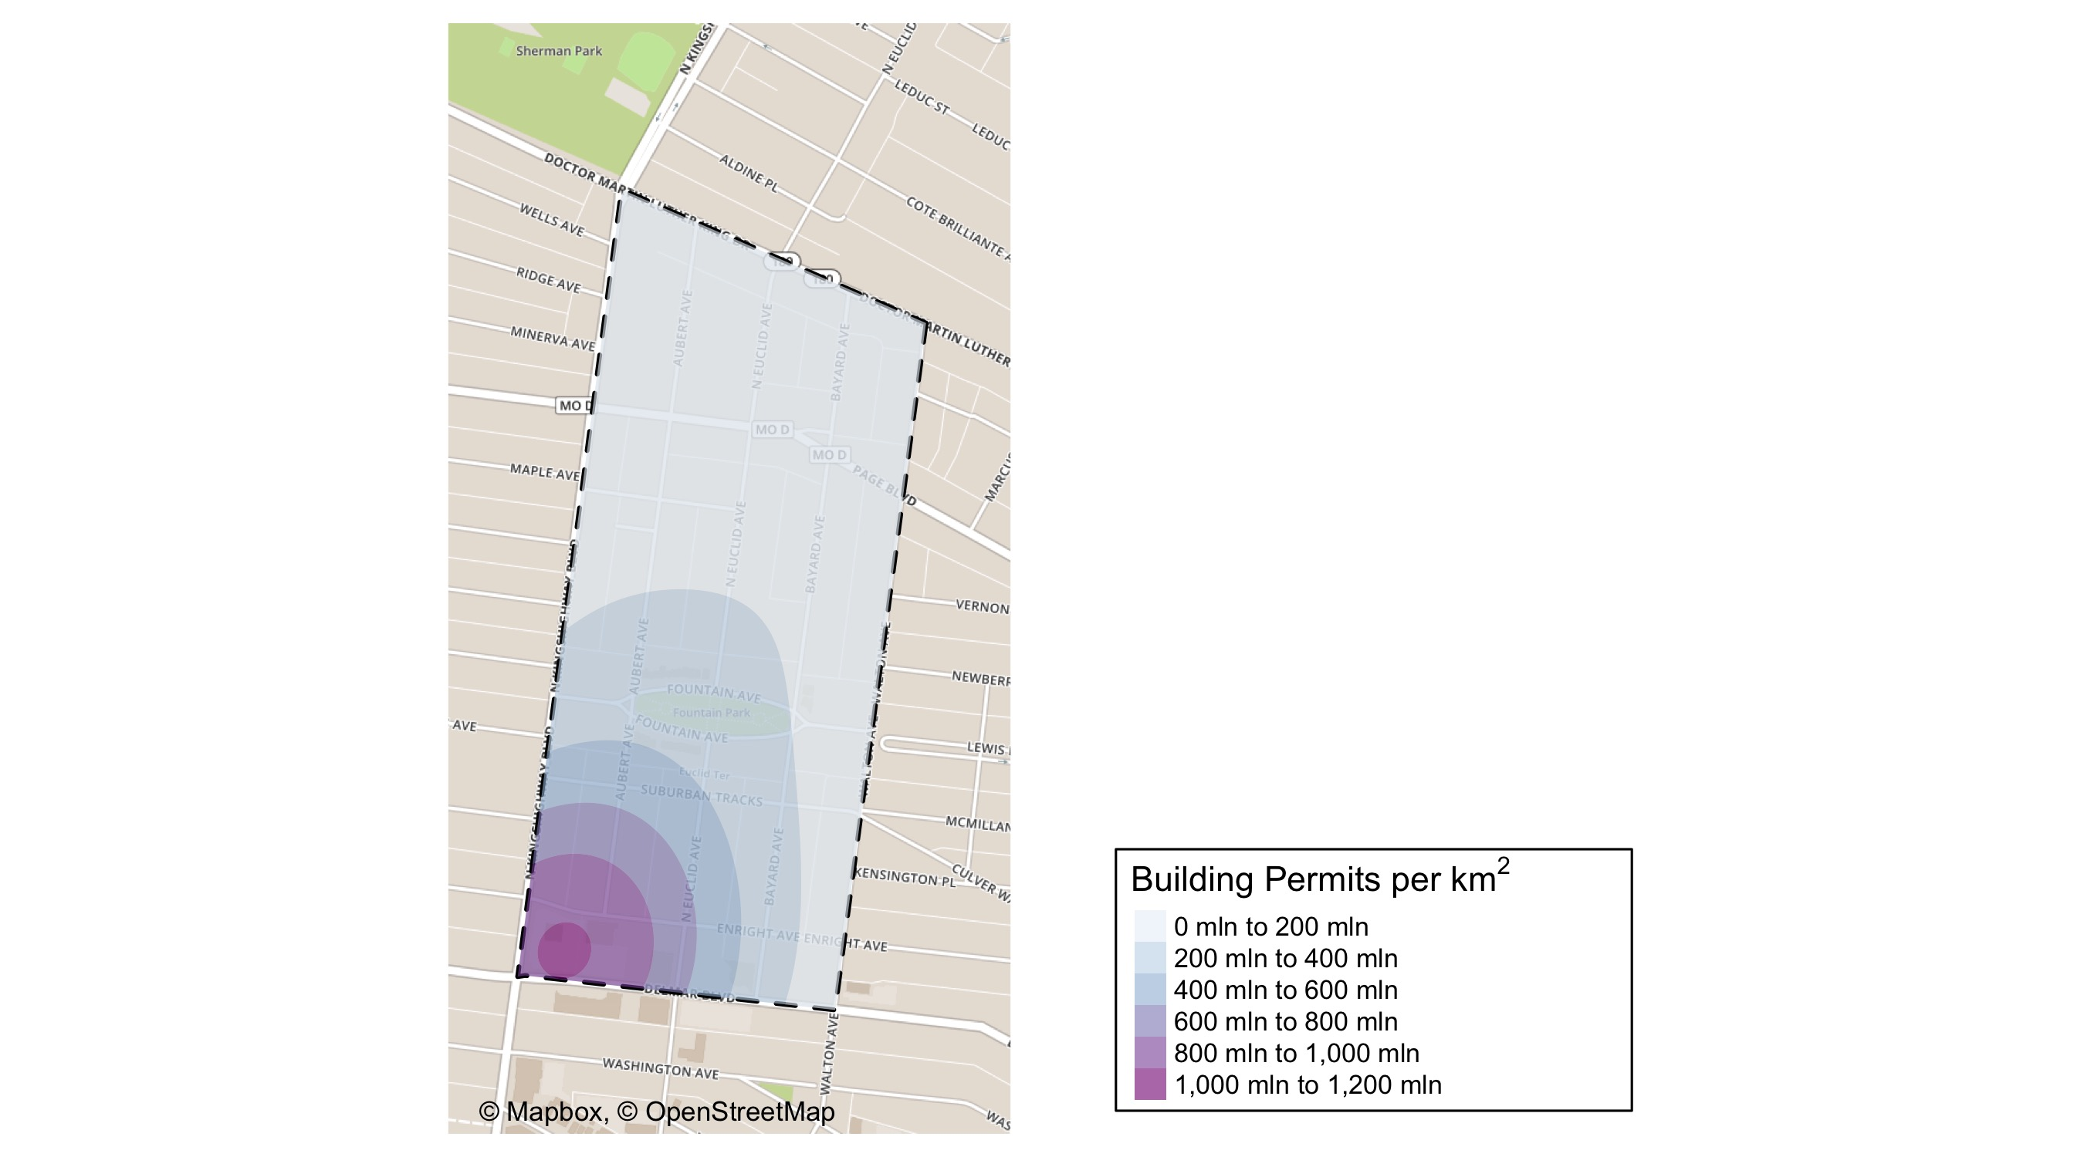
Fountain Park: Building Permit Density Map

Slide 57
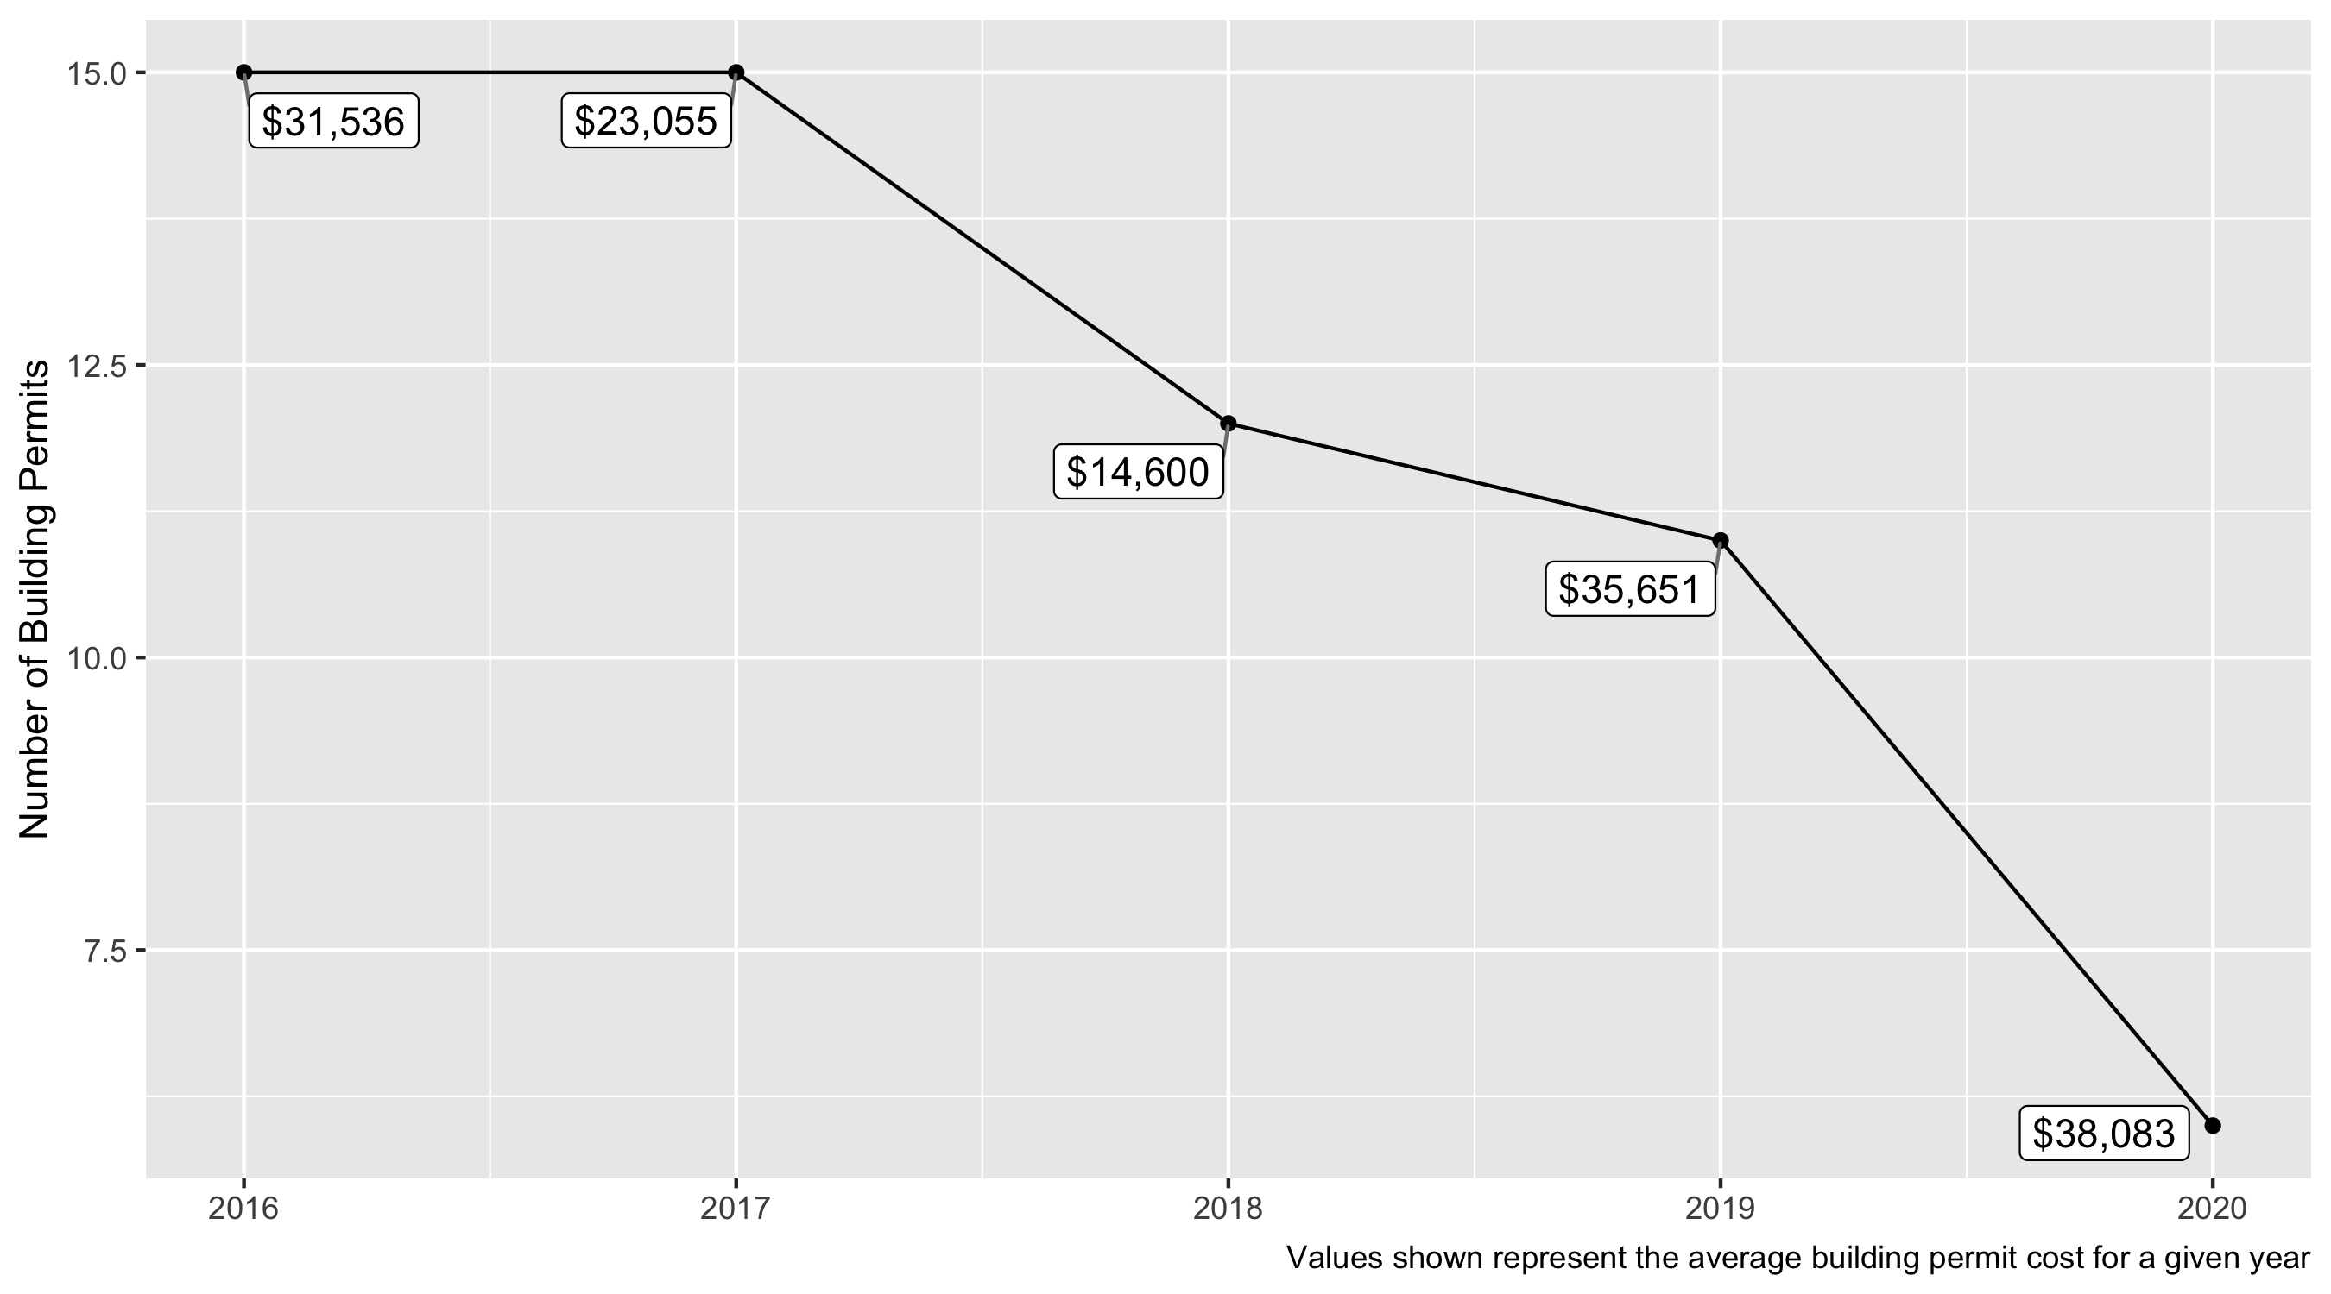
Fountain Park 5 Year Analysis

Slide 58
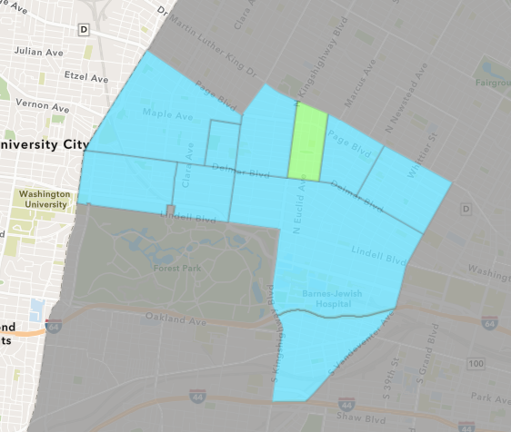
Fountain Park
2020 Neighborhood Cost Breakdown
Mean: $38,083
Median: $10,250
Range: $1,000 - $175,000

Slide 59
Fountain Park: Summary Notes
123 building permits in 2020
-28.49% change compared to 2019 (172 total building permits)
$2,691,675: Average building permit cost in 2020
1132.41% change compared to 2019 ($218,408)

Slide 60
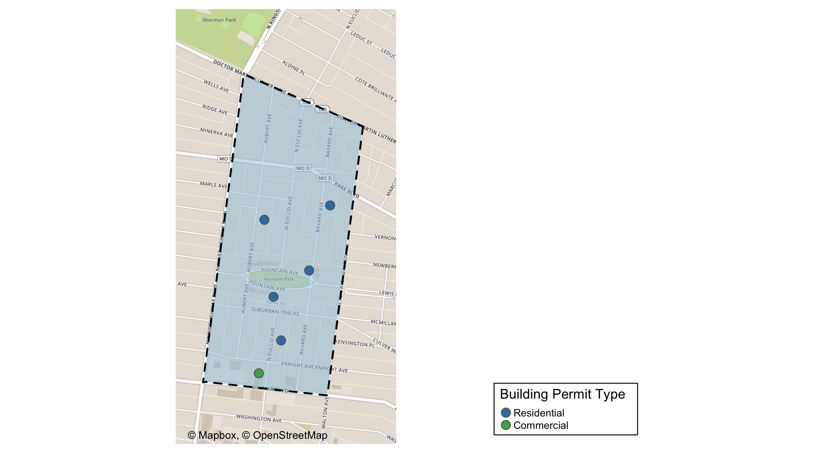
Fountain Park

Slide 61
Fountain Park
2020 | 2020 | 2020 | 2020
Permit Use | Average Cost | # of Permits | Total Value of Permits
Commercial | 30,000.0 | 1.0 | 30,000.0
Industrial | 0.0 | 0.0 | 0.0
Institutional | 0.0 | 0.0 | 0.0
Residential | 39,700.0 | 5.0 | 198,500.0
2019 | 2019 | 2019 | 2019
Permit Use | Average Cost | # of Permits | Total Value of Permits
Commercial | 18,721.7 | 3.0 | 56,165.0
Industrial | 0.0 | 0.0 | 0.0
Institutional | 0.0 | 0.0 | 0.0
Residential | 42,000.0 | 8.0 | 336,000.0

Slide 62
Fountain Park Individual Permit Breakdown
Owner | New Use | Cost | Address
KOCH, FREDERICK & MARJORIE DEL CARLO | Residential | 2,000.0 | 1202 AUBERT AV
BOOKER, RICHARD JR & | Residential | 10,500.0 | 1234 BAYARD AV
HUNT, VANESSA C | Residential | 10,000.0 | 764 N EUCLID AV
KINGSWAY DEVELOPMENT LLC | Residential | 175,000.0 | 4845 FOUNTAIN AV
ROOSEVELT TOWNE LTD PARTNERSHIP C/O | Commercial | 30,000.0 | 701 N EUCLID AV
LAMMERT, HOLLY R | Residential | 1,000.0 | 4900 FOUNTAIN AV

Slide 63
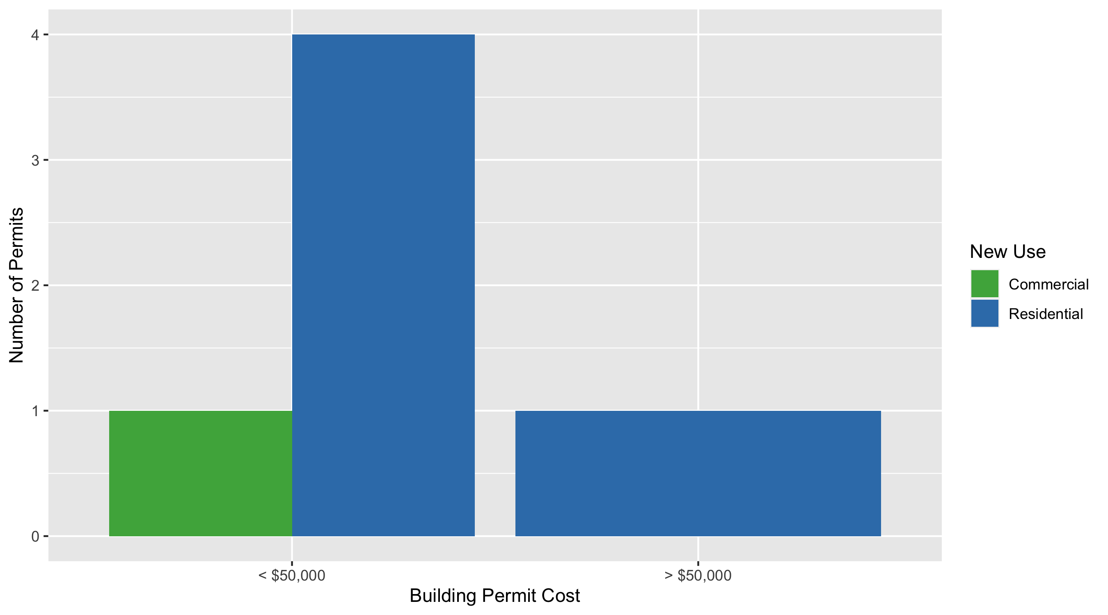
Fountain Park Permit Cost Breakdown

Slide 64
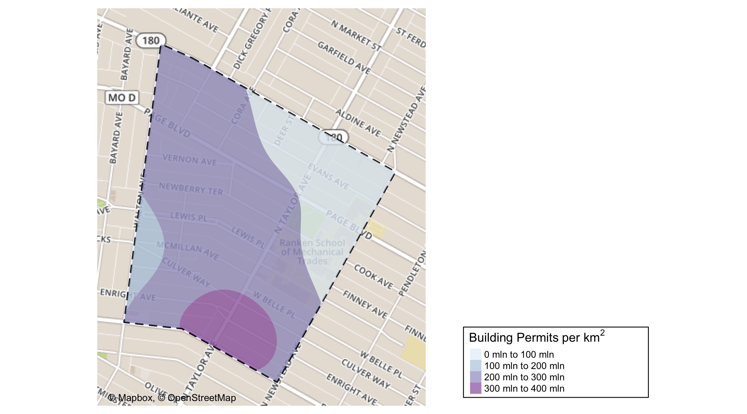
Lewis Place: Building Permit Density Map

Slide 65
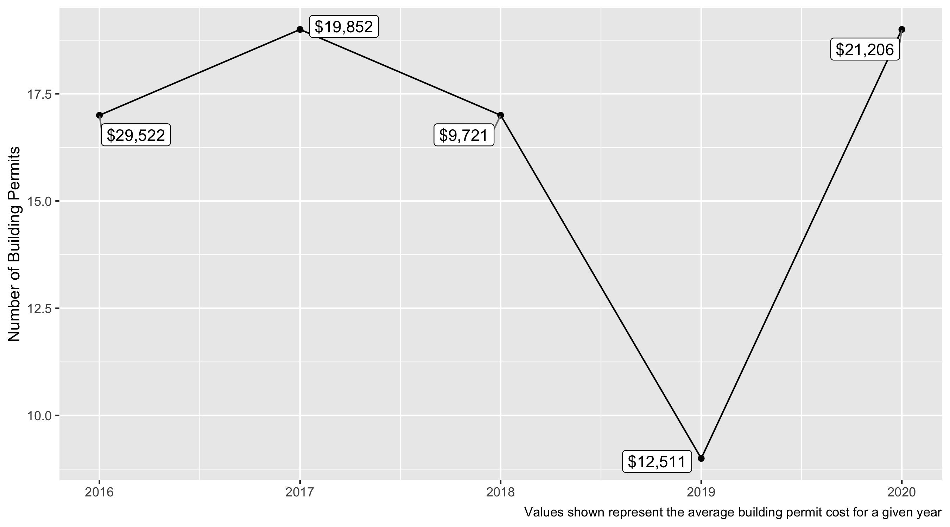
Lewis Place 5 Year Analysis

Slide 66
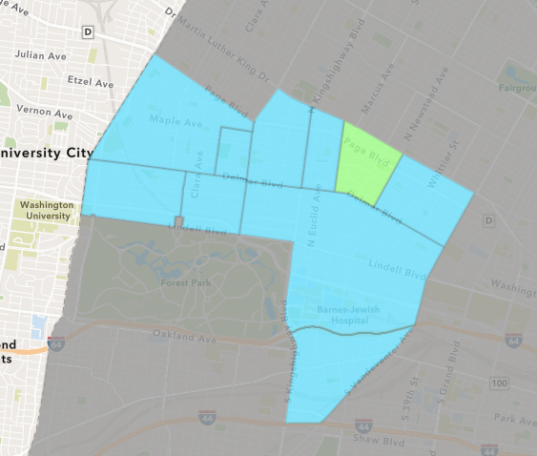
Lewis Place
2020 Neighborhood Cost Breakdown
Mean: $21,206
Median: $5,970
Range: $100 - $160,000

Slide 67
Lewis Place: Summary Notes
123 building permits in 2020
-28.49% change compared to 2019 (172 total building permits)
$2,691,675: Average building permit cost in 2020
1132.41% change compared to 2019 ($218,408)

Slide 68
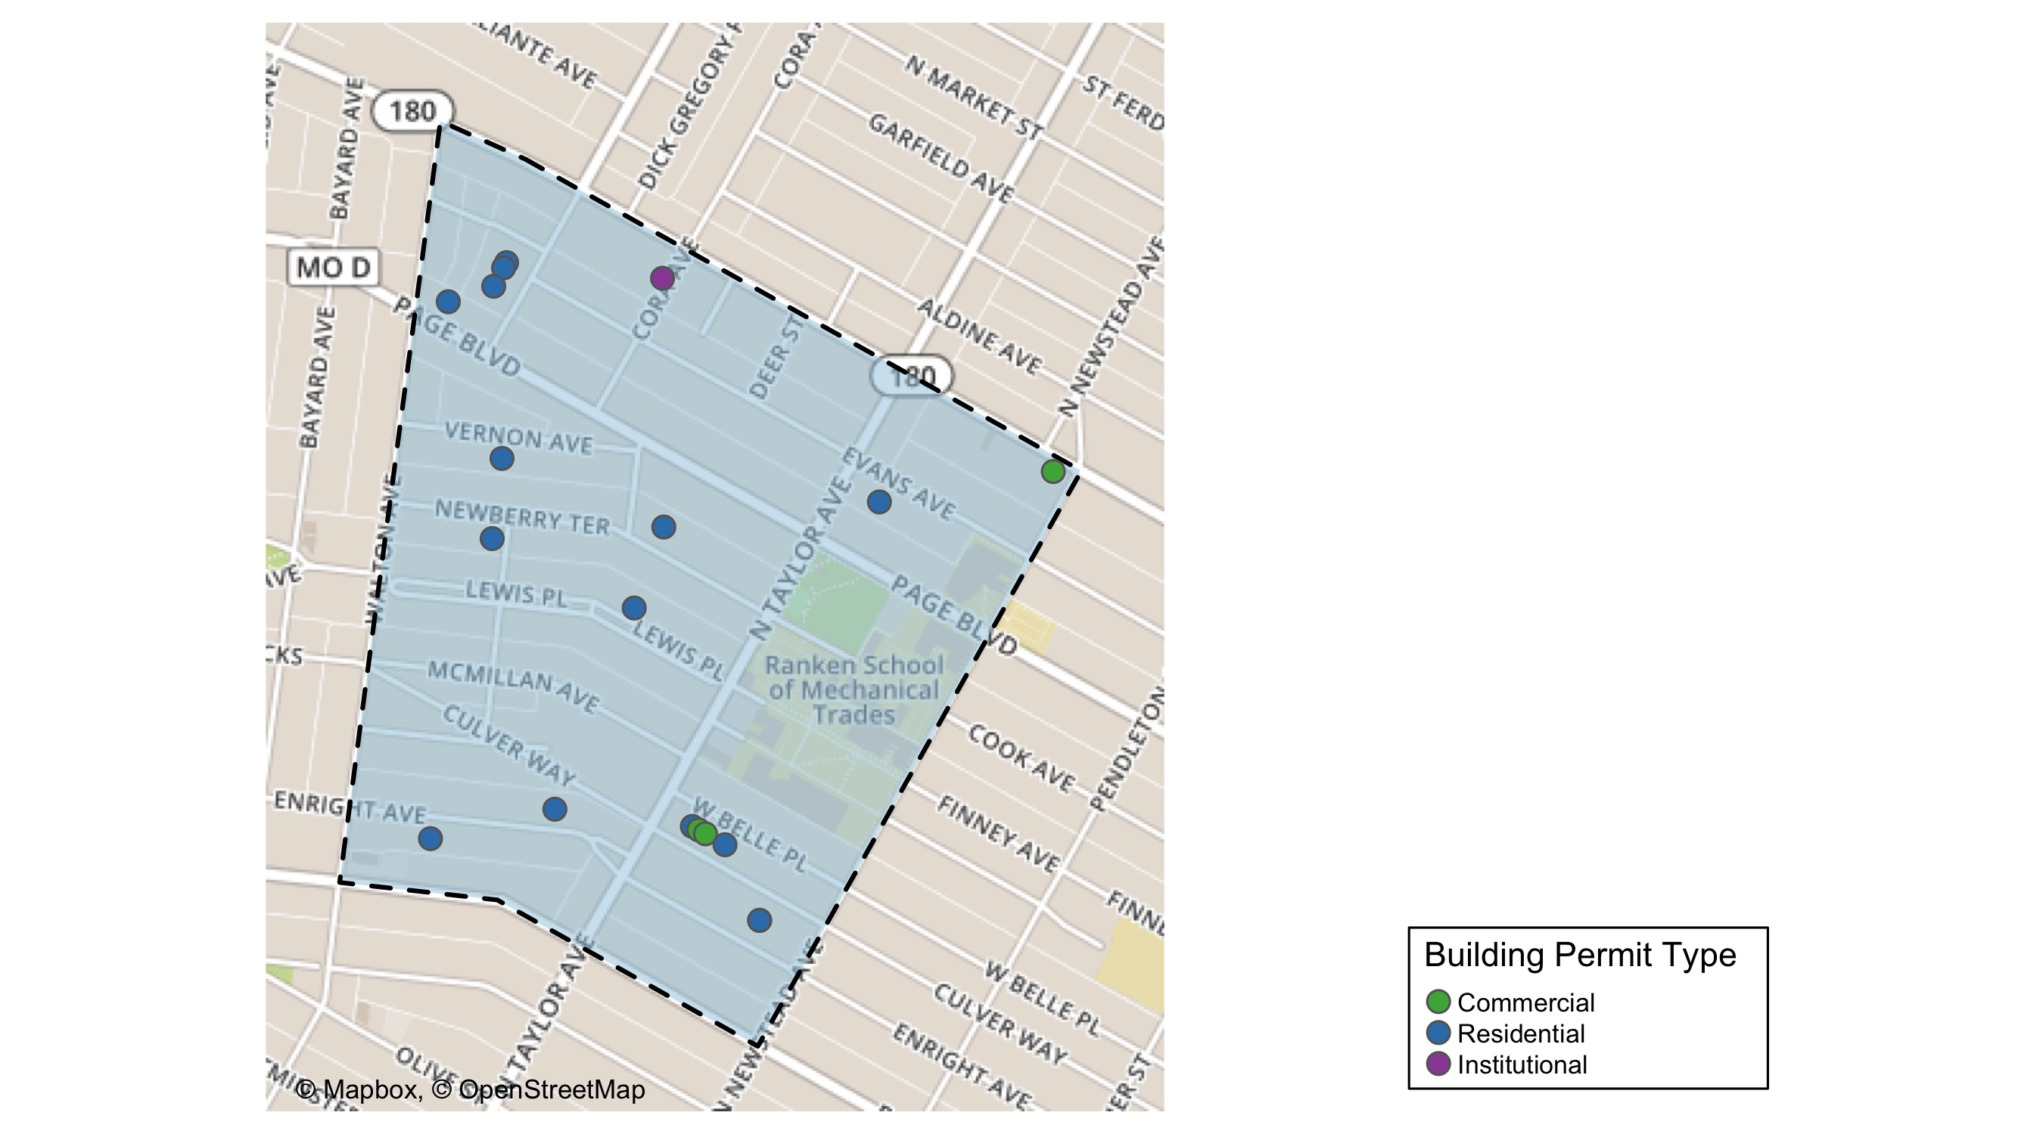
Lewis Place

Slide 69
Lewis Place
2020 | 2020 | 2020 | 2020
Permit Use | Average Cost | # of Permits | Total Value of Permits
Commercial | 3,400.0 | 3.0 | 10,200.0
Industrial | 0.0 | 0.0 | 0.0
Institutional | 10,000.0 | 1.0 | 10,000.0
Residential | 25,514.9 | 15.0 | 382,723.0
2019 | 2019 | 2019 | 2019
Permit Use | Average Cost | # of Permits | Total Value of Permits
Commercial | 15,000.0 | 2.0 | 30,000.0
Industrial | 0.0 | 0.0 | 0.0
Institutional | 0.0 | 0.0 | 0.0
Residential | 11,800.0 | 7.0 | 82,600.0

Slide 70
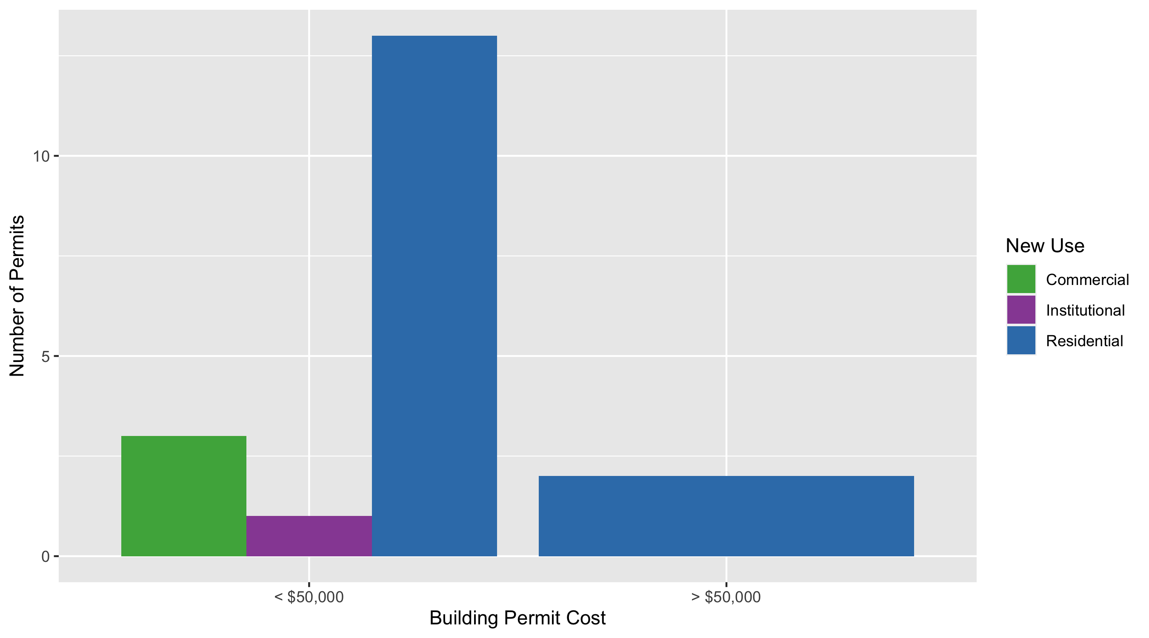
Lewis Place Permit Cost Breakdown

Slide 71
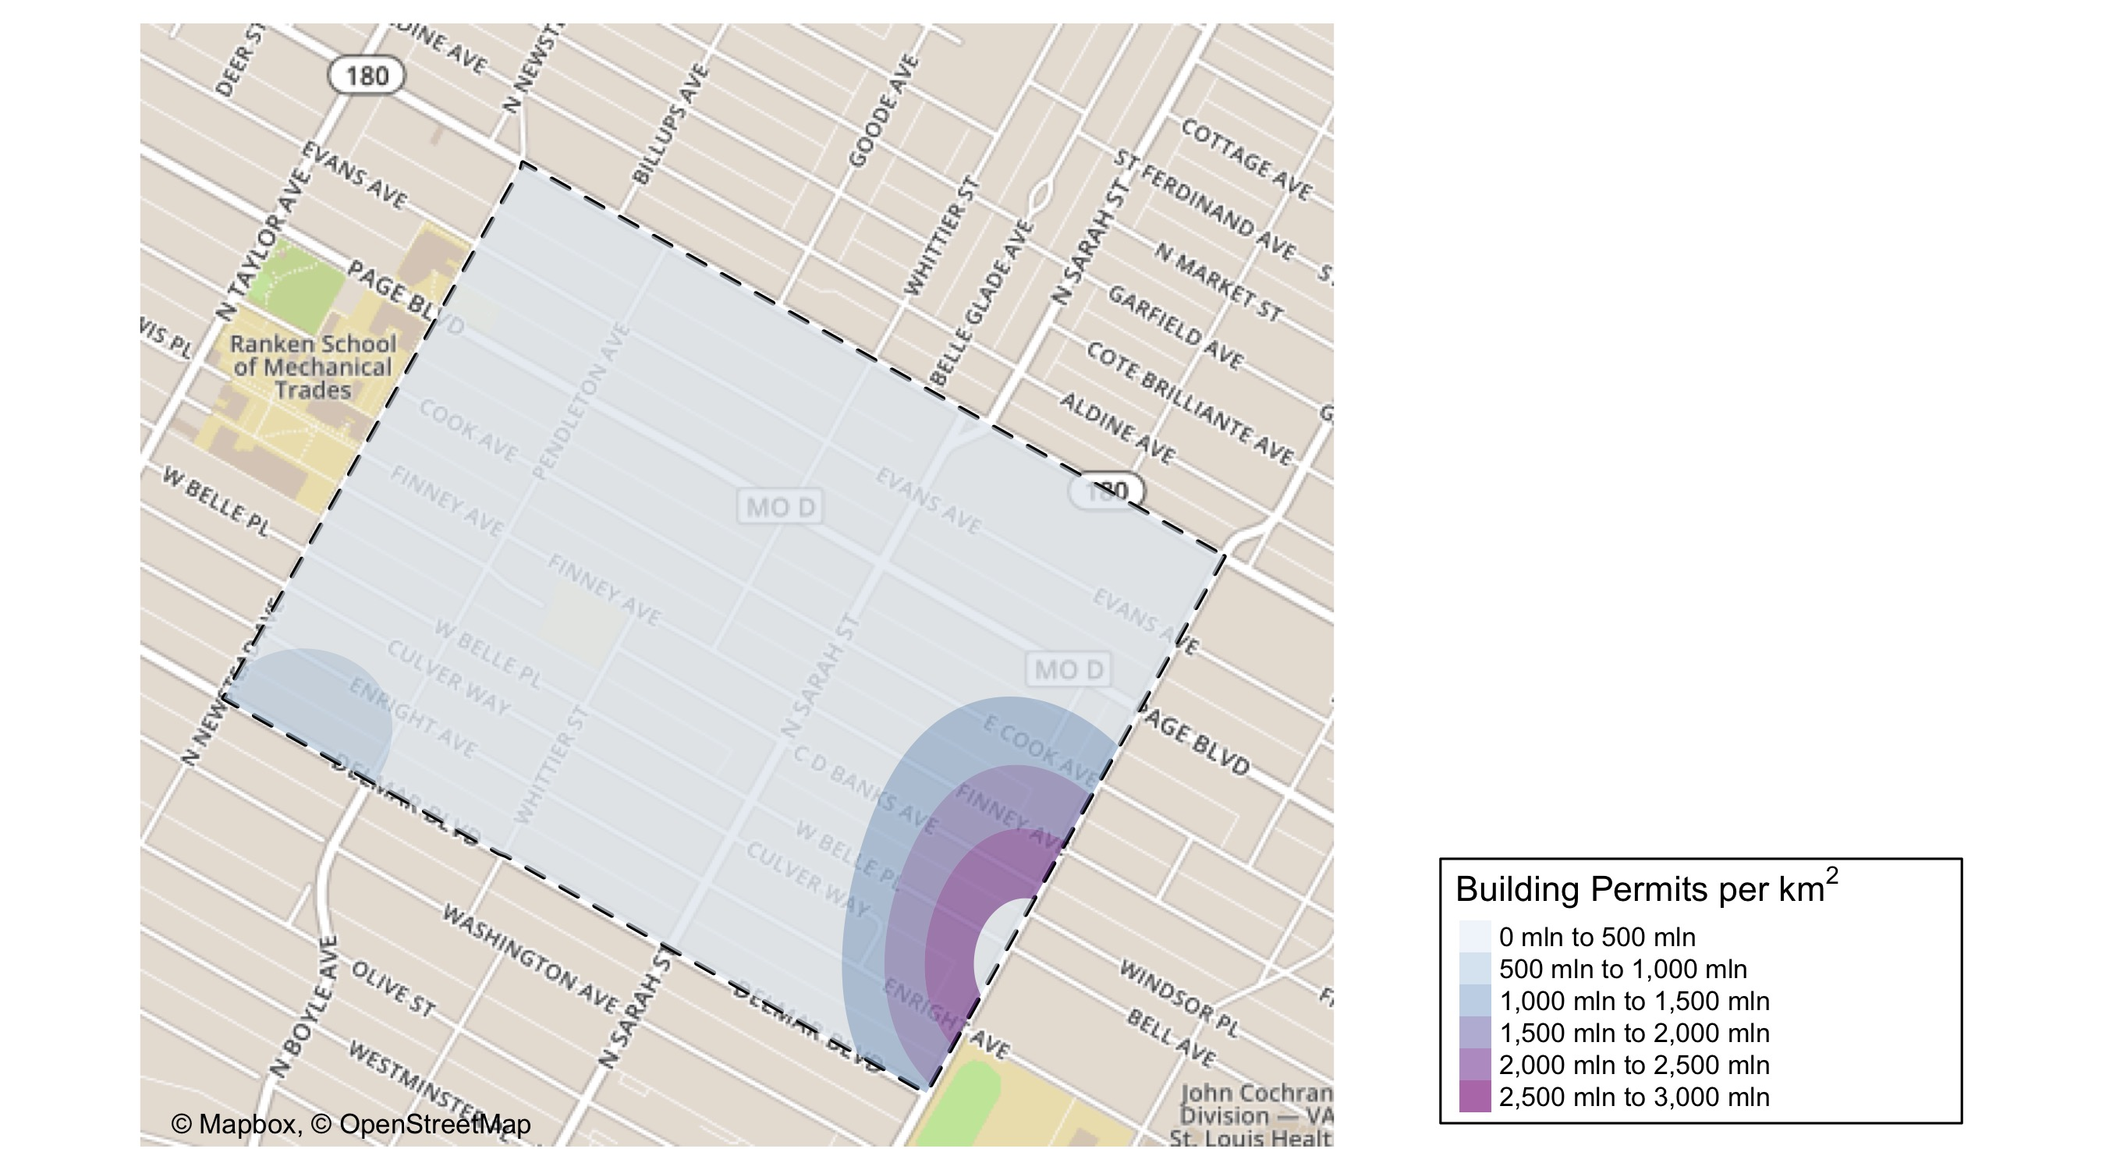
Vandeventer: Building Permit Density Map

Slide 72
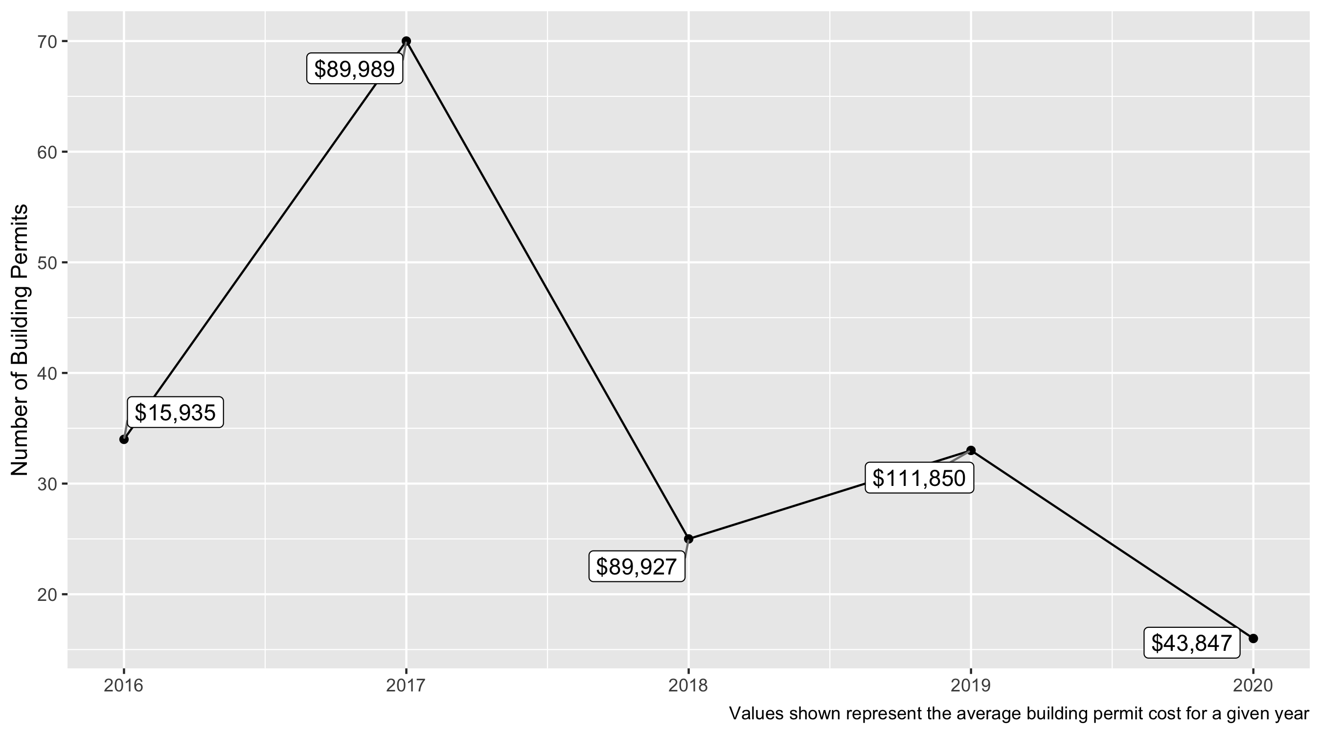
Vandeventer 5 Year Analysis

Slide 73
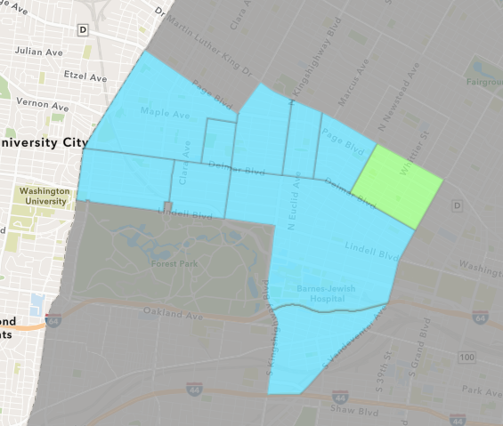
Vandeventer
2020 Neighborhood Cost Breakdown
Mean: $43,847
Median: $21,823
Range: $2,200 - $150,000

Slide 74
Vandeventer: Summary Notes
123 building permits in 2020
-28.49% change compared to 2019 (172 total building permits)
$2,691,675: Average building permit cost in 2020
1132.41% change compared to 2019 ($218,408)

Slide 75

Vandeventer

Slide 76
Vandeventer
2020 | 2020 | 2020 | 2020
Permit Use | Average Cost | # of Permits | Total Value of Permits
Commercial | 55,000.0 | 1.0 | 55,000.0
Industrial | 0.0 | 0.0 | 0.0
Institutional | 28,223.0 | 3.0 | 84,669.0
Residential | 46,823.3 | 12.0 | 561,880.0
2019 | 2019 | 2019 | 2019
Permit Use | Average Cost | # of Permits | Total Value of Permits
Commercial | 919,215.0 | 3.0 | 2,757,645.0
Industrial | 0.0 | 0.0 | 0.0
Institutional | 82,500.0 | 2.0 | 165,000.0
Residential | 27,443.1 | 28.0 | 768,407.0

Slide 77

Vandeventer Permit Cost Breakdown

Slide 78
Additional Notes
Data retreived from https://www.stlouis-mo.gov/data/
Building permits with a cost of $0 were dropped
Building permits that were cancelled were dropped
Infinite change indicates 0 permits in the current or previous time period/comparison month so there was a overall increase or decrease

